Slide 1
Available Proposal Tools: APT
Themiya Nanayakkara
JWST MASTER CLASS MELBOURNE 2022

Slide 2
The JWST Astronomer’s Proposal Tool
The Astronomer’s Proposal Tool (APT) is used to specify proposed observations for JWST and submit them for consideration, by the Time Allocation Committee (TAC).
The scientific justification PDF must be attached, at the bottom of the Proposal Information page, prior to submission.
APT is also a resource estimator.
Need a resource estimate for the TAC.
APT uses a system of overhead charges to make this resource estimate possible.

Slide 3
APT Basics
Observation – basic proposal design element specified by the user. Observations are divided into one or more visits by APT.
Visit – set of exposures (included overheads) obtained on a single guide star without scheduling interruptions. (This is the scheduling unit.)
Observation Template – GUI form filled out by the user.
Overhead – charged time for operations activities performed by the observatory.
Graphical Timeline – provides a visual display of overheads for each visit.
Visit Planner – checks the schedulability of an observation (including guide star availability).
Smart Accounting – updates the full proposal's resource estimates and remove excess overheads prior to submission.
Notes:
It is good practice to know some basic terminology as these will be mentioned many times when working with APT
Observation Template –
- Parameters depend on selection of instrument and mode.
- Contains the exposure specifications.
Visit Planner checks GS availability, Target Visibility Tools do not

Slide 4
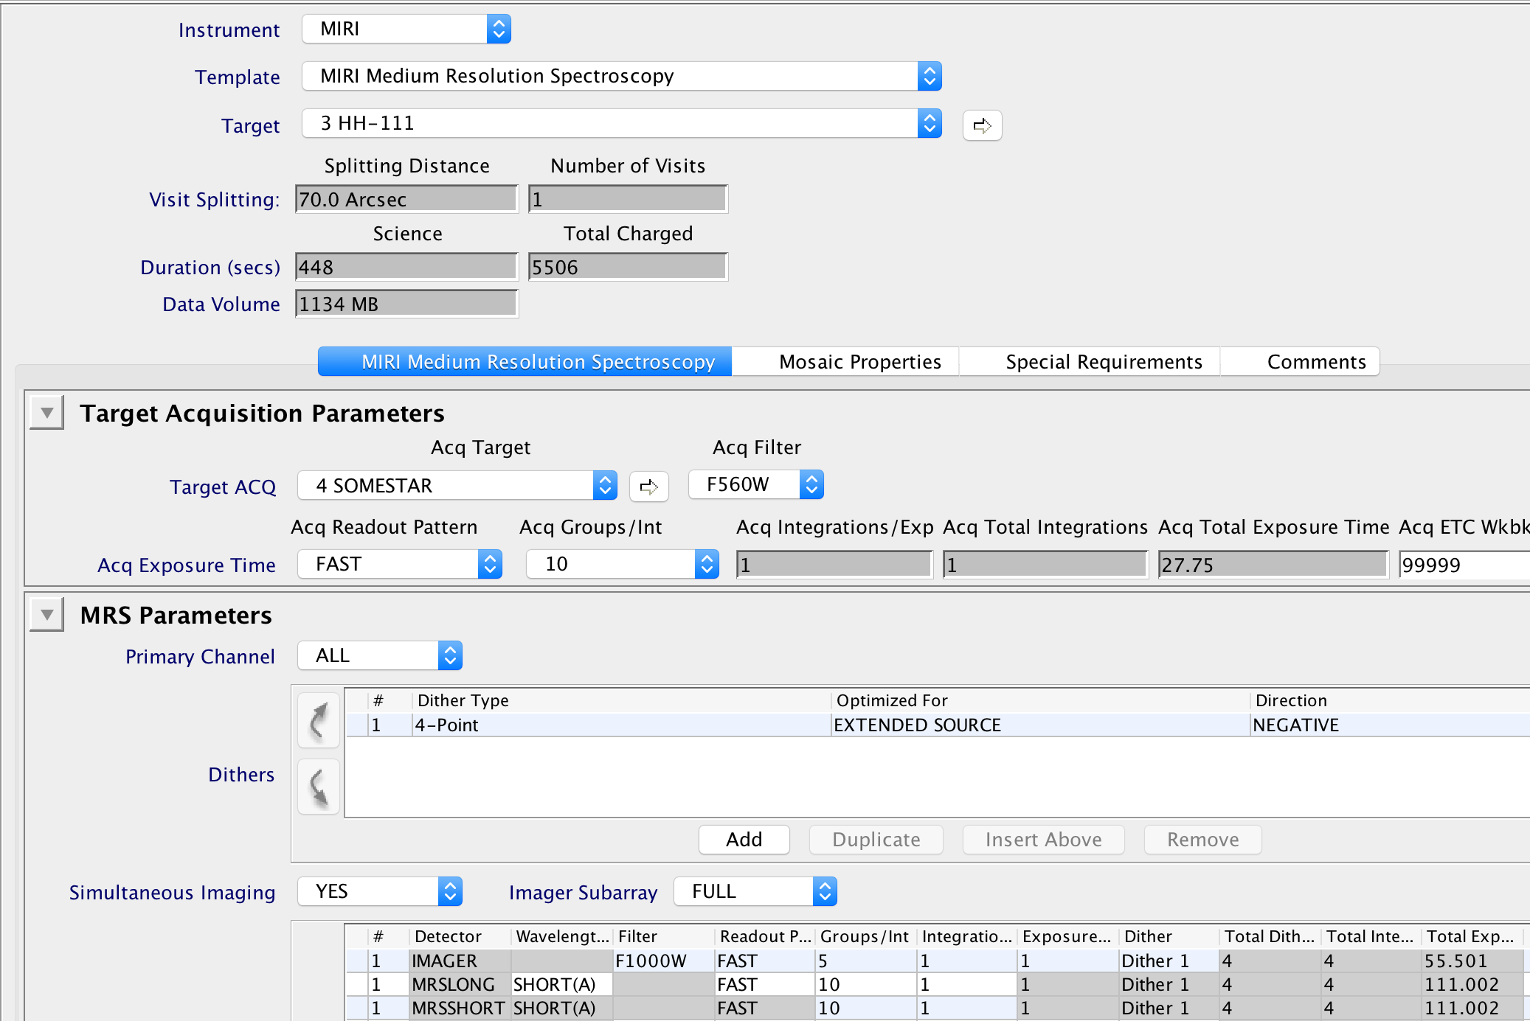
What is an APT Observation?
User specified
Single observing mode (template)
All parameters for exposures and scheduling requests
Additional Resource: JDox Article: APT Observations
Notes:
Observations are what the user specifies in APT using observation templates
Observations are designed within a single observing mode (template) based on the selected instrument
All the parameters for exposures in the observation and scheduling request are displayed
Additional Resource: https://jwst-docs.stsci.edu/jwst-astronomers-proposal-tool-overview/apt-workflow-articles/apt-observations

Slide 5
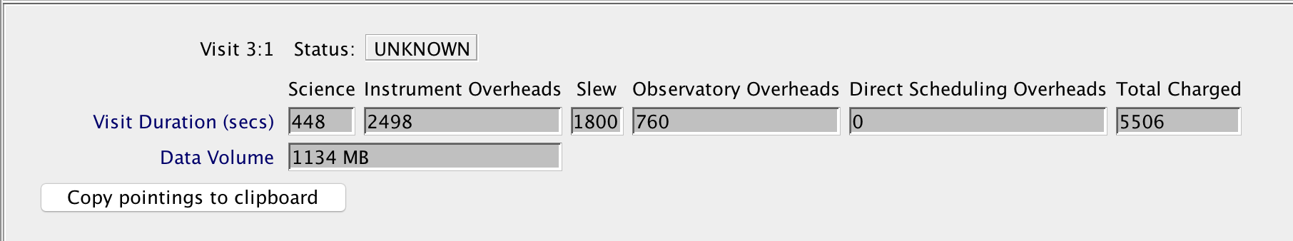
What is an APT Visit?
A Visit is set of exposures and associated overheads that can be executed, without interruption, using a single guide star.
This is what makes Visits the “scheduling unit” used by the scheduling system.
A typical Visit includes
Slew to guide star position
Instrument overheads
Guide star acquisition
Target acquisition (if needed)
Small Angle Maneuvers (SAMs)
Science exposures
The duration of a Visit also includes:
Observatory overheads
Station keeping
Momentum management
Direct scheduling overheads
Very tight timing constraints
Rapid turnaround of target of opportunities
APT shows the following when clicking on a Visit, which cannot be directly edited, and is for user information only.

Slide 6
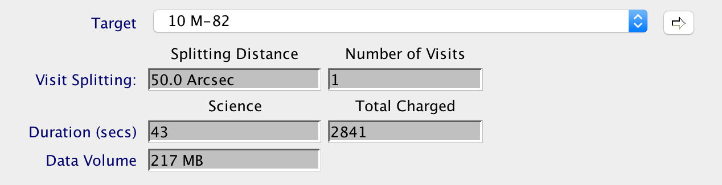
APT Visit Splitting Distance
Users specify observation, then APT splits an observation into one or more Visits depending on the Visit Splitting Distance.
This allowed distance for offsets (or dithers) within a Visit is based on the expected guide star availability, which drop off towards higher galactic latitudes.
The Visit Splitting Distance used by APT is between 35”–80” depending on the Galactic latitude of the target. Exceptions:
30” for moving targets
38” for WATA Target Acq for NIRSpec
The Visits of a multi-visit observation are not guaranteed to execute in a continuous manner unless a special requirement (to be discussed in more detail later) is specified.
Galactic Latitude | Pointing Change |  | Galactic Latitude | Pointing Change
0° ≤ |b| < 10° | 80" |  | 45° ≤ |b| < 50° | 45”
10° ≤ |b| < 15° | 70” |  | 50° ≤ |b| < 60° | 40”
15° ≤ |b| < 20° | 65” |  | 60° ≤ |b| < 65° | 30”
20° ≤ |b| < 25° | 60” |  | 65° ≤ |b| < 70° | 40”
25° ≤ |b| < 35° | 55” |  | 70° ≤ |b| < 80° | 35”
35° ≤ |b| < 45° | 50” |  | |b| ≥ 80° | 45”
Ex: At the Observation-level, the target is M-82, which has a visit splitting distance of 50.0”
Additional Resource: JDox Article: APT Visit Splitting
Notes:
The allowed distance assumed for offsets within a given visit is a function of the galactic latitude of your target position, because the number of potential guide stars drops off toward higher galactic latitudes. Alternatively, one can say that larger areas are serviceable by a single guide star at lower Galactic latitudes where more stars are available.
Since science visits will be added in with observatory activities, calibration activities and other science visits as needed to make the observatory work well, multi-visit observations are not guaranteed to execute in a continuous manner unless a timing special requirement is placed on the observation.
When mosaicking, if the motion from one tile to another is too large, APT will break the observation into multiple visits.
Additional Resource: https://jwst-docs.stsci.edu/jwst-astronomers-proposal-tool-overview/additional-apt-functionality/apt-visit-splitting

Slide 7
APT Observation Templates

Slide 8
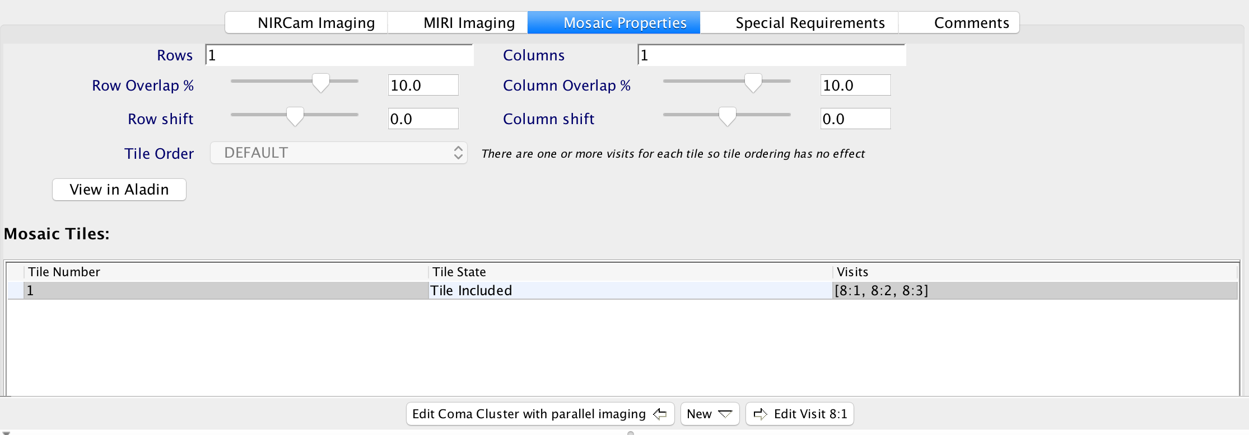
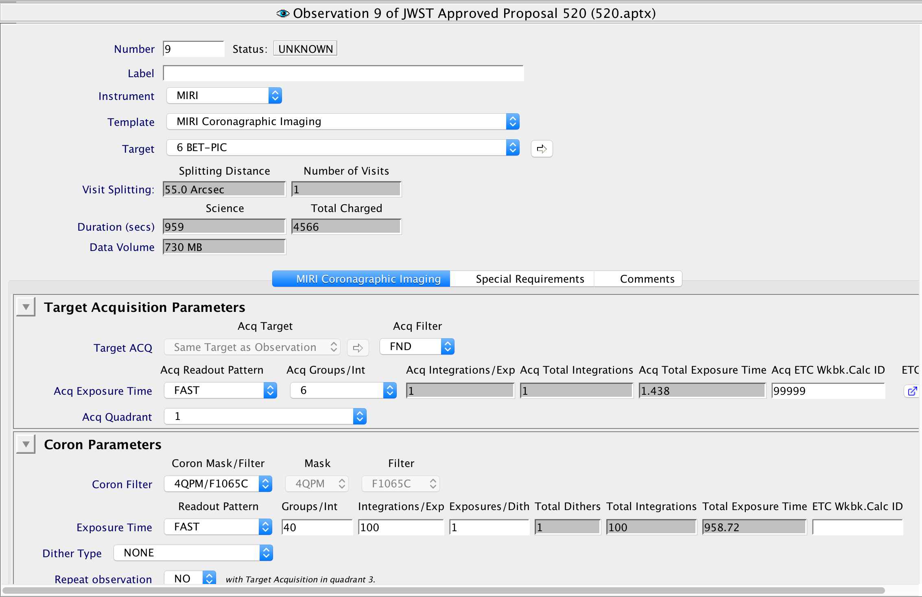
APT Observation Templates
Template Form changes based on selection of instrument and observing mode.
APT templates give users access to all supported JWST observing modes.
Examples:
Coronagraphy
Mosaiking
Coordinated Parallels
Additional Resource: JDox Article: APT Observation Templates
Notes:
Coronagraphy requires a number of parameters not needed by other modes, so this only shows up when coronagraphy templates are selected.

Slide 9
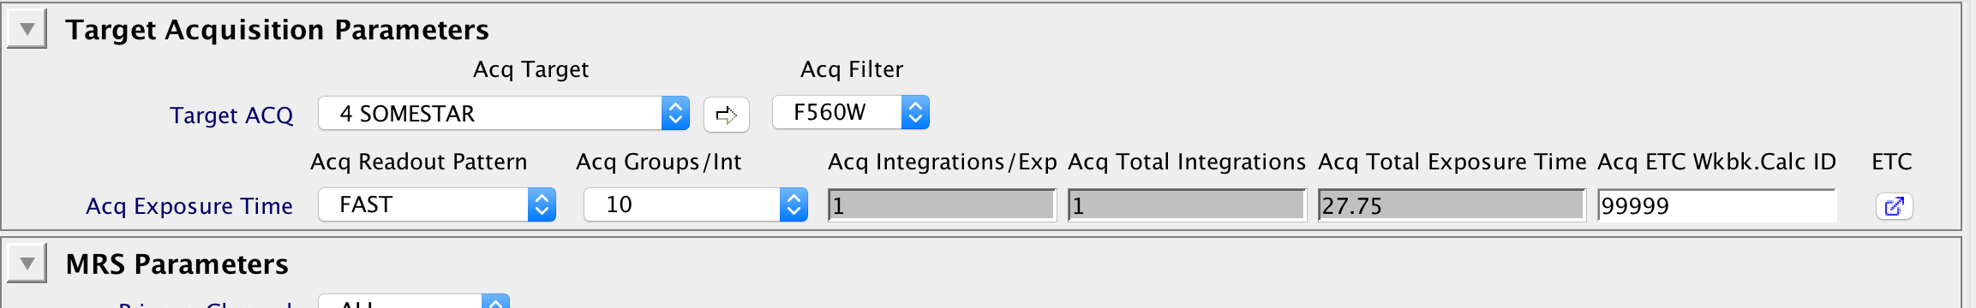
APT Target Acquisition
The target acquisition target should be the brightest source in the Region Of Interest (ROI).
Some APT templates…
Have no target acquisition
Require a target acquisition
Or the target acquisition is optional
Consider your science case and expected pointing performance to decide whether a TA is necessary.
NOTE: If the target acquisition fails, the observation fails!
**Users should obtain accurate target acquisition exposure information using the JWST Exposure Time Calculator and transfer to APT.**
Useful: annotation box, useful for documenting your calculation ID!
Additional Resources:
JDox Article: APT Target Acquisition
JDox Article: APT to ETC Connectivity
Notes:
Based on the observing template and the requirements of the science program, TA may or may not be needed
The APT GUI contains a box to enter a tracking number ([ETC workbook ID].[calculation number]) to provide tracking information, and shows a yellow caution if no entry is present. ETC and APT don’t talk to one another, so be sure to fill this in, in case you need to reference your ETC calculation later.
The hand—on exercises will cover more specific TA options for each mode.
Additional Resources:
https://jwst-docs.stsci.edu/jwst-astronomers-proposal-tool-overview/apt-workflow-articles/apt-target-acquisition
https://jwst-docs.stsci.edu/jwst-etc-to-apt-interface-support-information/jwst-apt-etc-connectivity

Slide 10
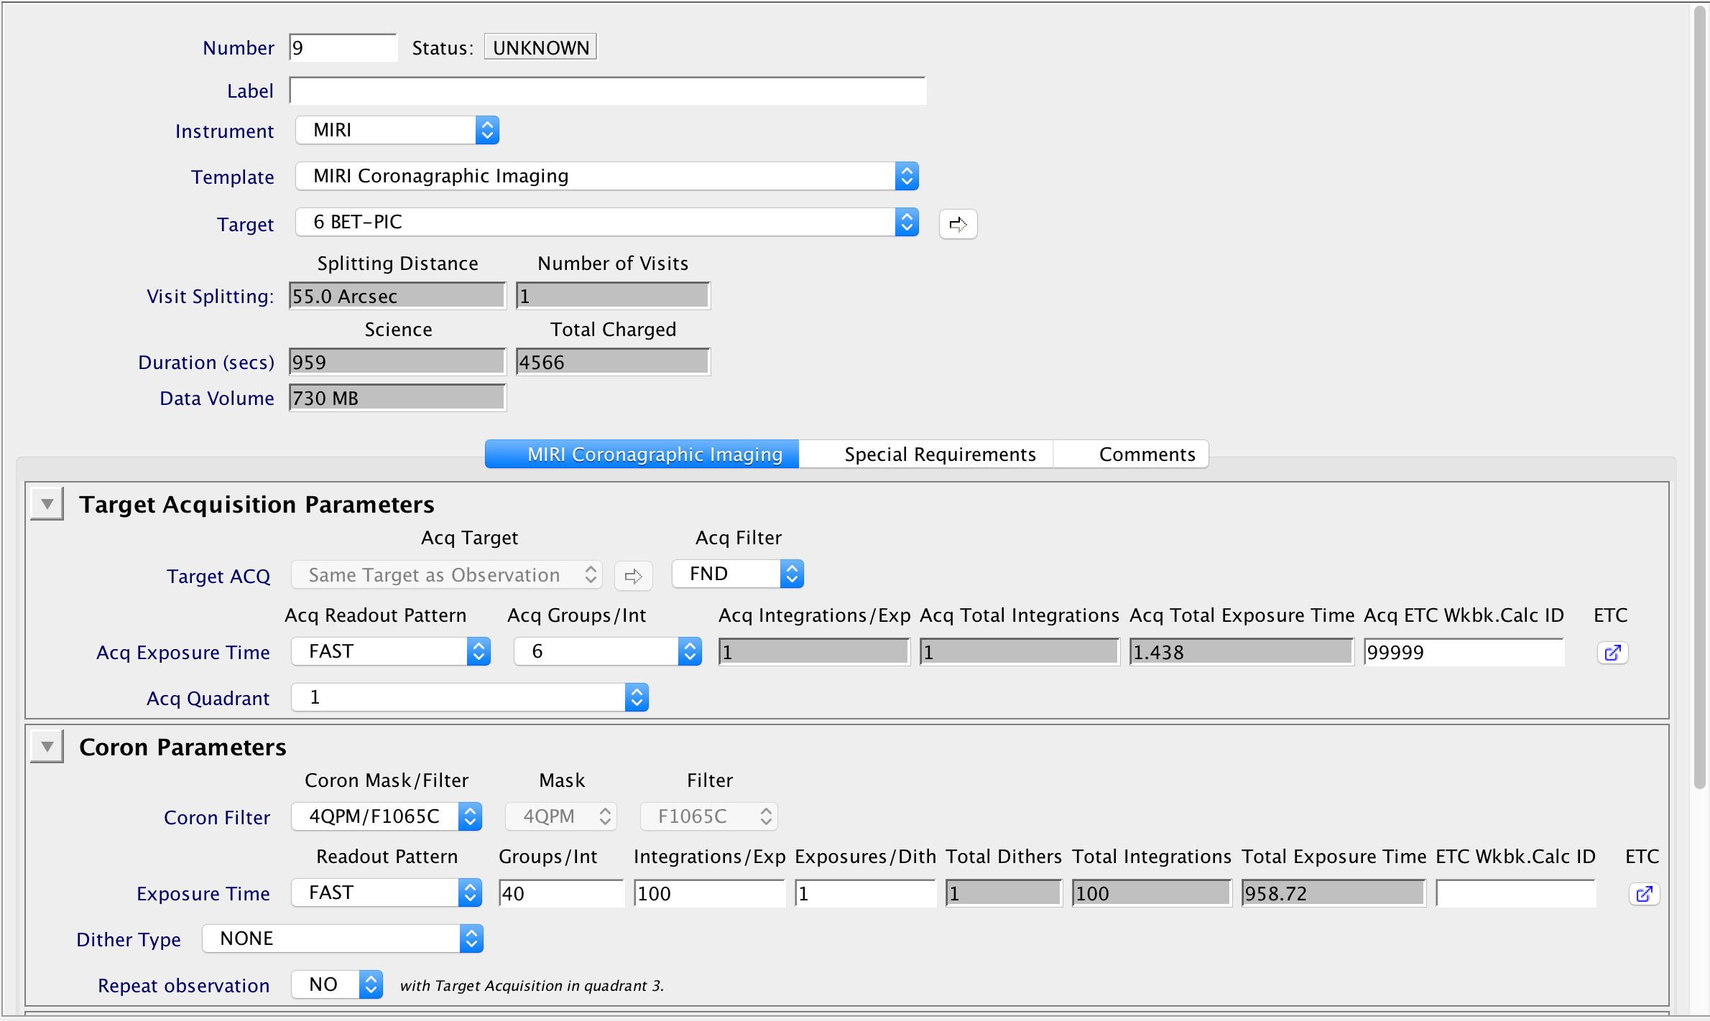
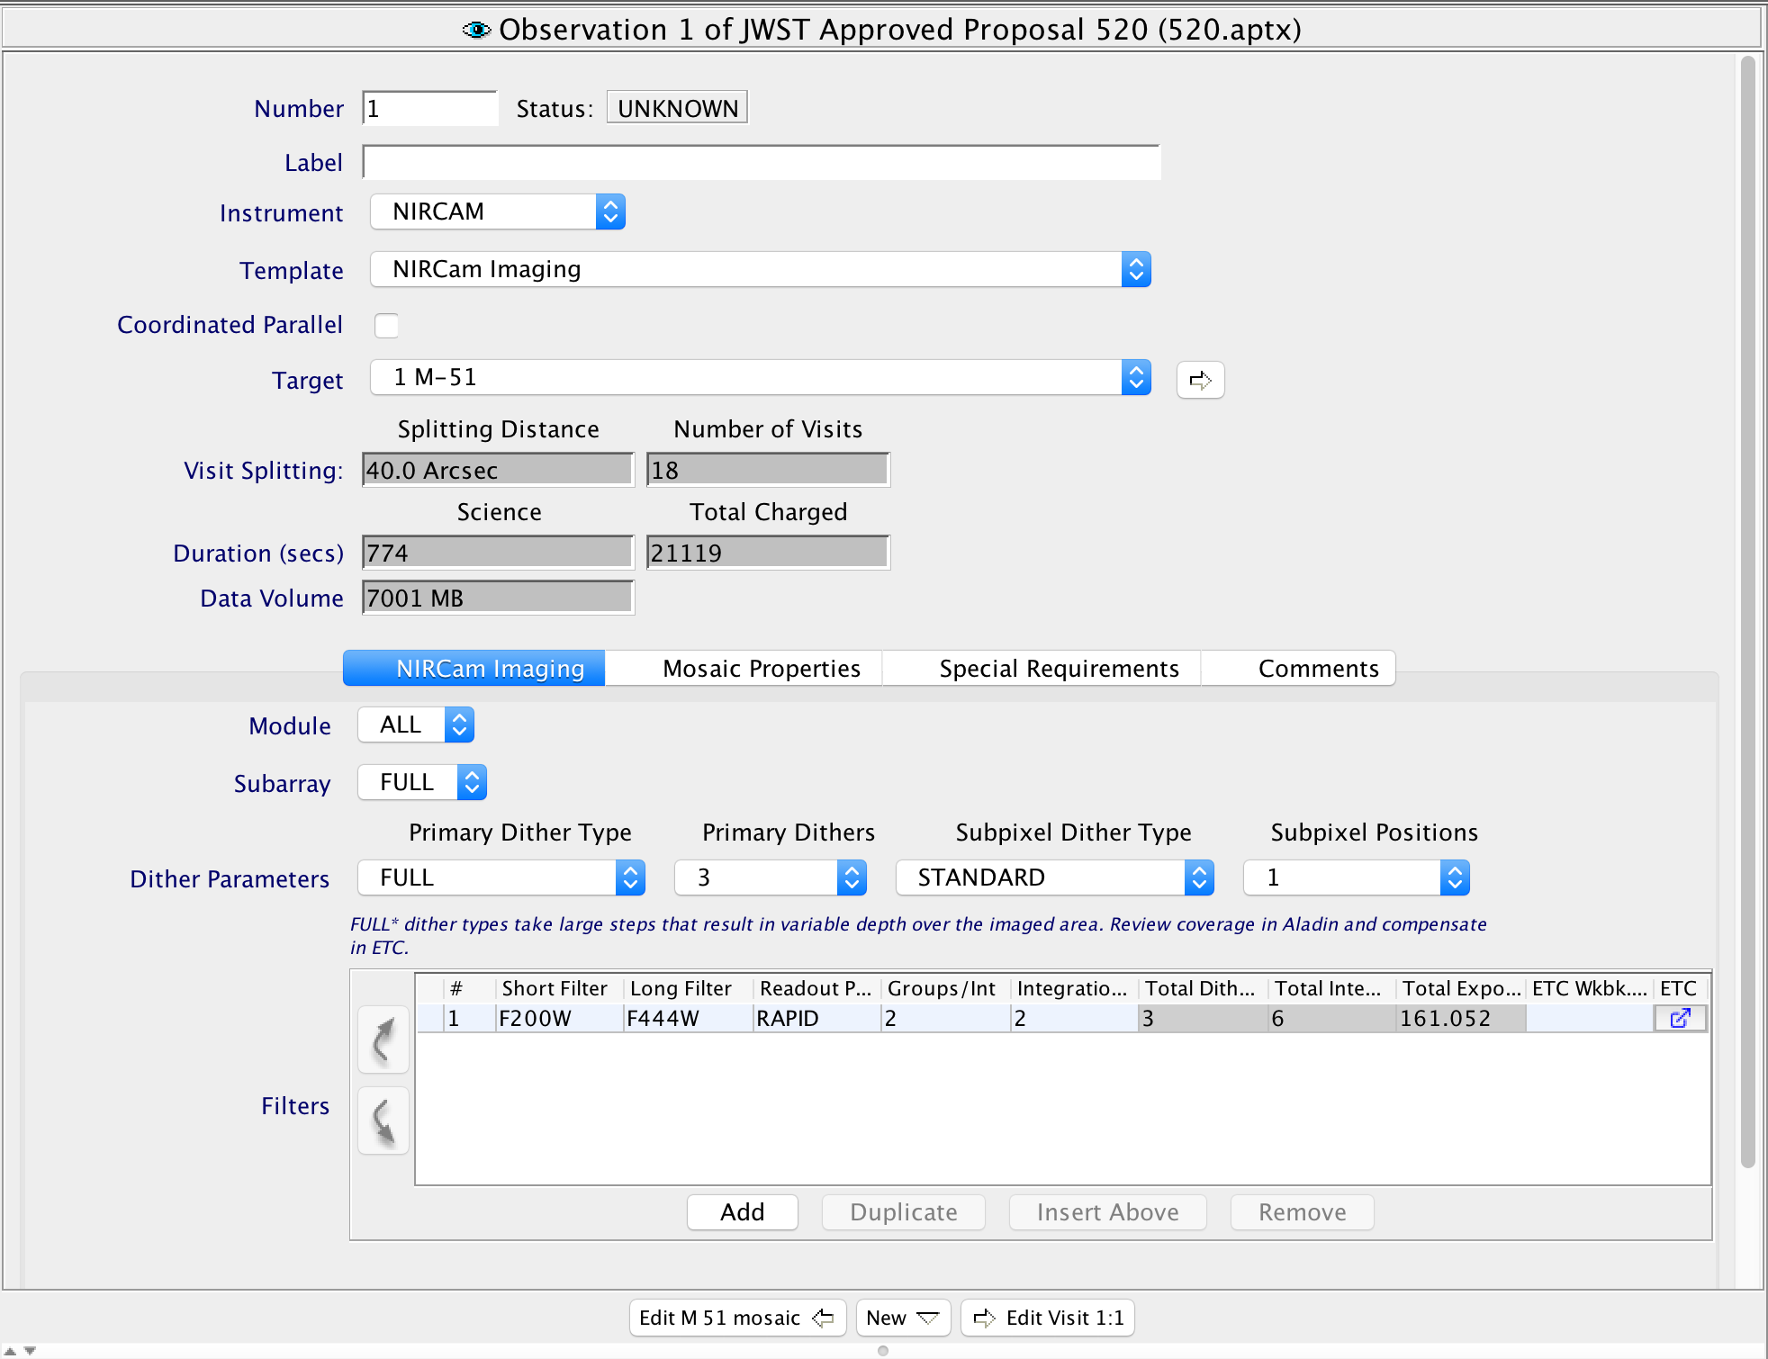
APT Observation Templates - TA
TA needed
No TA needed
Notes:
APT will show you if a TA is necessary. First case, no TA needed. Second case, TA is needed.

Slide 11
APT Special Requirements

Slide 12
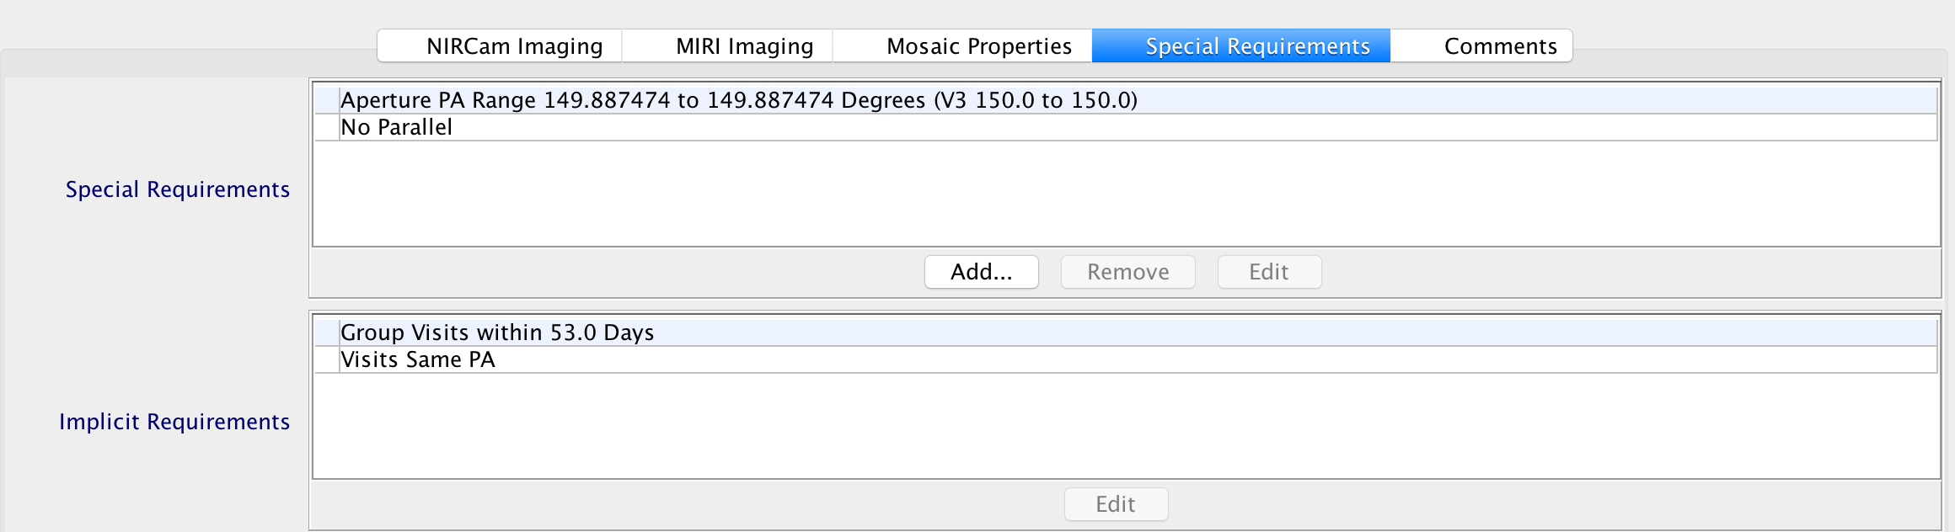
Special Requirements
Additional constraints placed on specific observations.
Applied at the observation level.
Affects all visits within an observation
Must be justified by the science goals
Can decrease scheduling availability
Explicit requirements: set by user
Implicit requirements: set by APT and reported for your information.
Examples: Timing, Position Angle, Target of Opportunity, Background Limited, Offset, No Parallel
Additional Resources:
JDox Article: APT Special Requirements
YouTube Video Tutorial: APT Special Requirements
Notes:
Implicit requirements are uneditable.

Slide 13
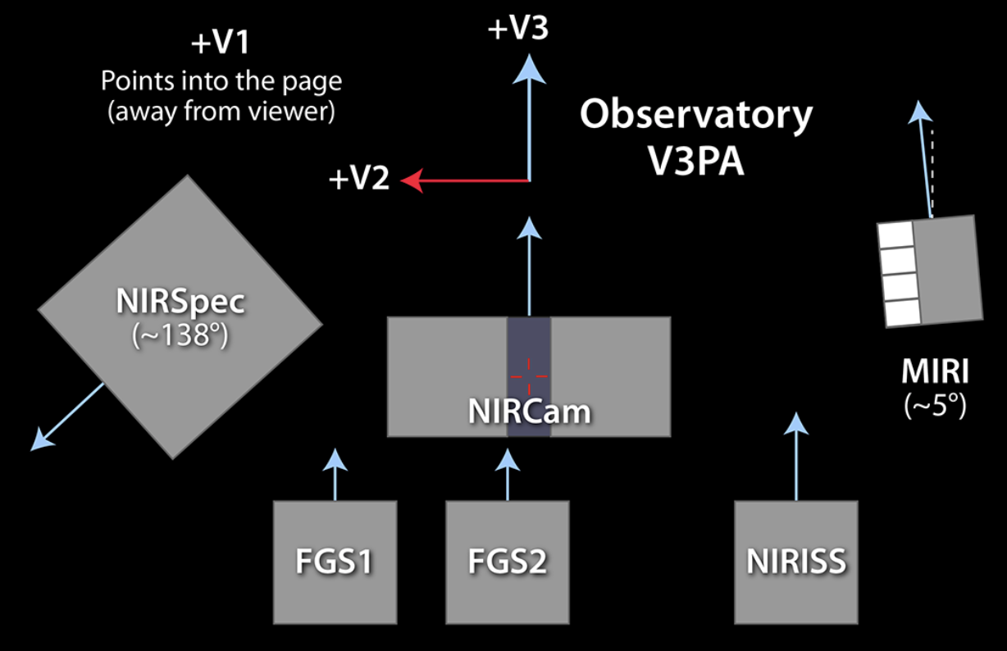
V3 Position Angle (V3PA) vs Aperture Position Angle (APA)
V3PA is the observatory reference angle used by APT diagnostics and the scheduling system.
APA is specific to each instrument, and is the PA (degrees east of north as projected onto the sky) of the reference axes shown as light blue arrows at left.
Instrument | Offset Angle from V3
NIRCam | 0.0°
MIRI | 4.45°
NIRISS | 0.57°
NIRSpec | 138.5°
Additional Resource: JDox Article: Position Angles, Ranges and Offsets
Notes:
In words, just highlight that APT and Aladin are showing V3PA, but that users can specify the desired position of a given field of view on the sky specifically using the APA option. This will be covered more in-depth during the APT hands-on.
In looking at the information in the table, also just point out that only NIRSpec and MIRI reference axes are noticeably offset from V3.
Additional Resource: https://jwst-docs.stsci.edu/observatory-functionality/jwst-position-angles-ranges-and-offsets

Slide 14
APT Visit Planner

Slide 15
APT Visit Planner
The APT visit planner performs a detailed check of the schedulability of the visits in observations, including target visibility, constraint checking, and whether guide stars are available.
Diagnostic information is provided when scheduling checks fail. But interpreting this information can be tricky.
Additional Resources:
JDox Article: APT Visit Planner
YouTube Video Tutorial: APT Visit Planner
Notes:
Additional Resources:
https://jwst-docs.stsci.edu/jwst-astronomers-proposal-tool-overview/apt-workflow-articles/apt-visit-planner
https://www.youtube.com/watch?v=nMWW5m7VgiI&feature=youtu.be

Slide 16
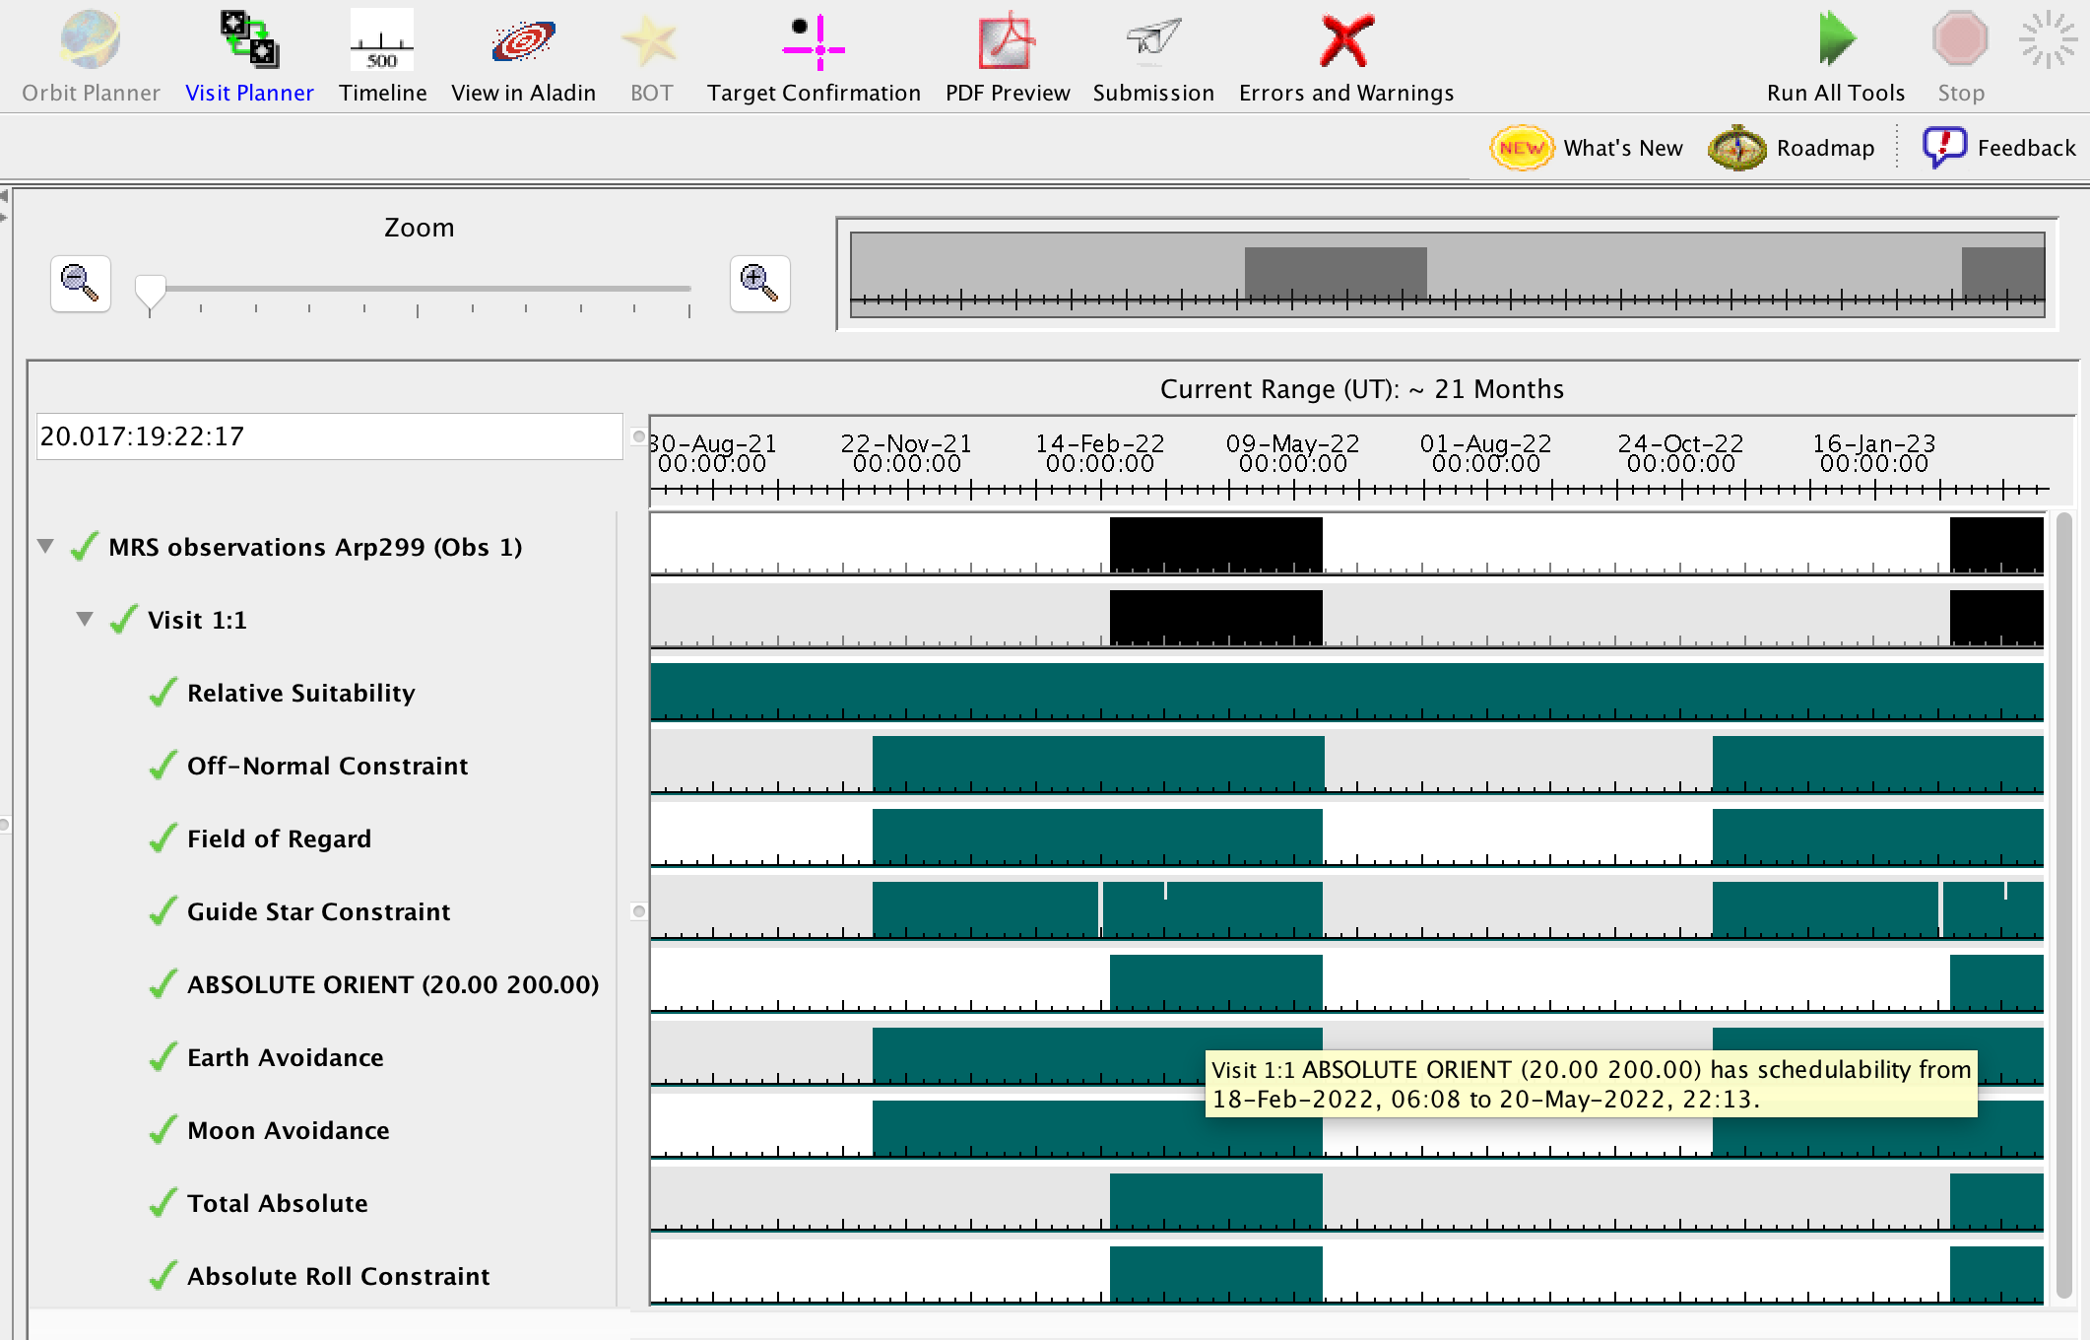
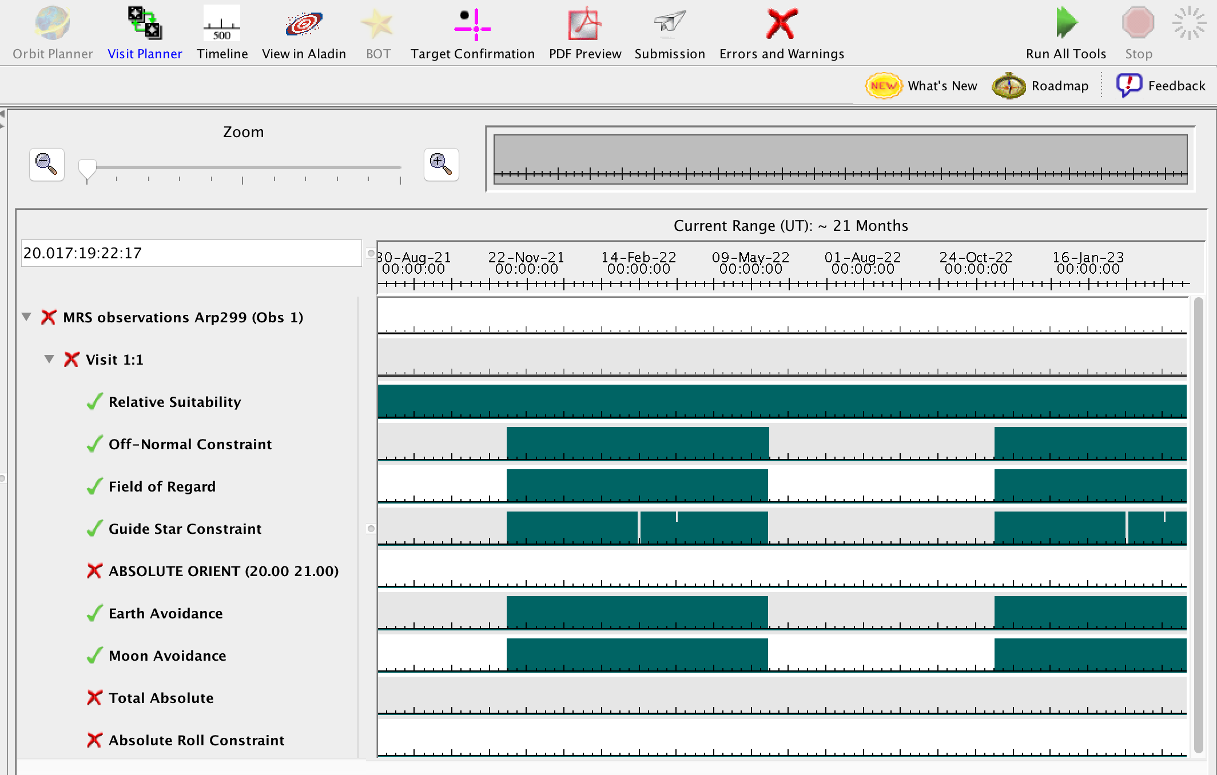
APT Visit Planner Diagnostics – Position Angle Problems
Note: all constraints windows need to have a window of schedulability at the same time.
Now it is schedulable!
Notes:
Point out green bars are the constraint windows
Hover cursor over a constraint window to view schedulable time range in pop up window

Slide 17
Other Useful APT Capabilities

Slide 18
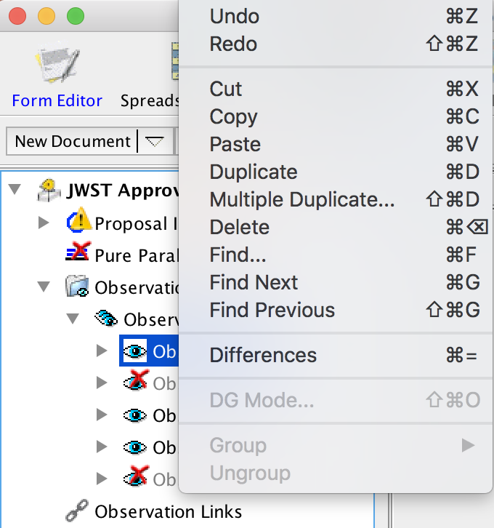
Other Useful APT Capabilities
Find – can search on any part of the APT file (proposal info, target, observation, etc.)
Duplicate/Multiple Duplicate a target, observation folder or observation
Copy/Paste a target, observation folder, or observation within your proposal or into a separate proposal.
Differences – can difference two separate proposals, or on any part of the APT file (two parts of proposal info, two targets, two observations, etc.)
Important: to revise a label to provide clear tracking within your proposal.
Notes:
Example: During the creation many folders and was confused by the labels that were not kept up to date. Best to provide a meaningful/unique name for the label to keep things organized.

Slide 19
APT Overheads and Smart Accounting

Slide 20
APT Overheads
JWST autonomous operations are complex.
There are many activities that need to occur to set up each observation. While most are fairly short, in the ensemble, the time can add up.
Slewing and settling take time, even for small motions.
By policy, JWST amortizes the estimated time for calibrations and observatory and charges to each program.
Pre-launch estimate for this is 16%, which is included by APT.
But to first order, overheads are what they are.
There is not too much you can do to lower your overhead charges by changing details in APT.
The Smart Accounting step in APT makes a reasonable attempt to lower artificially high overheads.
Our best advice to you is to concentrate on the science you want to do and don’t be overly concerned about overheads!

Slide 21
APT Overheads, continued
Direct overheads – activities directly associated with an observing program
major slews
mechanism motion times
guide star acquisition times
small angle maneuvers
target acquisitions
Indirect overheads – activities performed for the general support of science observations (16%)
calibrations
momentum management
wavefront sensing and control
other observatory maintenance activities
Instrument overheads – activities directly associated with each instrument
Filter/grating changes
detector readout
Instrument operations script compilation time
Additional Resource:
JDox Article: JWST Overheads and TIme Accounting Overview
Notes:
To make a reasonable overall estimate of resources, APT applies different kinds of overheads to different activities.
Overheads for JWST observations occur in 3 major categories
Indirect overheads – activities directly associated with an observing program, such as major slews, mechanism motion times, guide star acquisition times, small angle maneuvers (SAMs; i.e., motions between dither points), and target acquisitions
Direct overheads – activities performed for the general support of science observations. This includes calibrations, momentum management, wavefront sensing and control, as well as other observatory maintenance. A pro-rated fraction of indirect overhead time is assigned to each proposal (~16% JWST time)
Instrument overheads – activities directly associated with each instrument, such as filter changes, detector readout, and operations script compilation
Additional Resource: https://jwst-docs.stsci.edu/observatory-functionality/jwst-observing-overheads-and-time-accounting-overview

Slide 22
APT Overheads, continued
Many overheads are known from ground testing, and can be applied deterministically (those occurring within a visit)
mechanism motions (filter or grating wheel rotations, other setup activities).
Small Angle Maneuvers (SAMs) (e.g., motions between dither steps or mosaic tiles).
target acquisition time (when needed).
Statistical time estimates – assumed average time of activities that depend on the exact sequence of events when scheduled.
Ex: Initial slew time from previous observation to the first visit of your observation cannot be known by APT.
Scheduling studies indicate an average initial slew time of 1800 s.
This is charged once per observation, but see below (Smart Accounting)
Some overheads are combinations!
Guide star acquisition time assumed includes a statistical estimate of how often initial failures and retries will need to be executed.
But then this fixed time is charged to each visit.
Notes:
The time assumed for each overhead activity is calculated either deterministically or statistically.
Deterministic time estimate – known time of activities that are associated directly with a visit, such as guide star acquisition, target acquisition (when appropriate), any mechanism motions (including filter wheels), and SAMs
Statistical time estimate – assumed time of activities that depend on the exact sequence of events scheduled for the observatory, such as major slew time from previous target to the first visit of each target

Slide 23
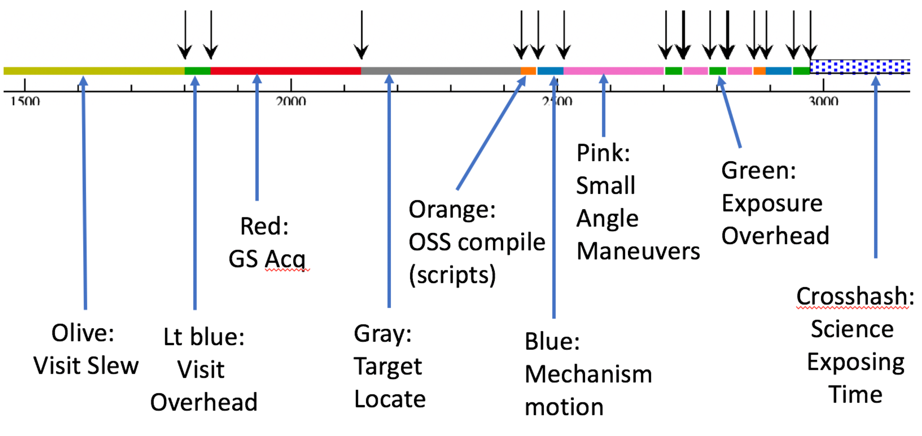
APT Graphical Timeline
Shows a summary of various overheads affecting the proposed observations.
Provides you with insight into the major steps that occur and the times accounted to each.
Is not meant to represent the actual detailed set of events that occur in the onboard execution of the observation.
Additional Resources:
JDox Article: APT Graphical Timeline
YouTube Video Tutorial: APT Graphical Timeline
Notes:
The graphical timeline is not meant to represent the actual detailed set of events that occur in the onboard execution of the observation. Rather, it is a tool to provide the user with insight into the major steps that occur and the times accounted to each within the APT timing model.
Additional Resources:
https://jwst-docs.stsci.edu/jwst-astronomers-proposal-tool-overview/additional-apt-functionality/apt-graphical-timeline
https://www.youtube.com/watch?v=G22dSLFTjCY

Slide 24
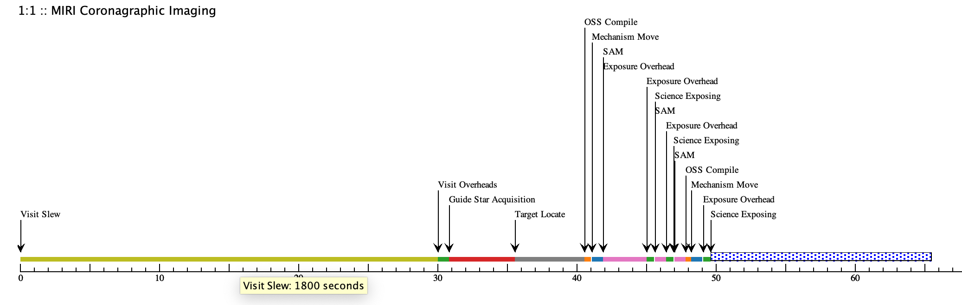
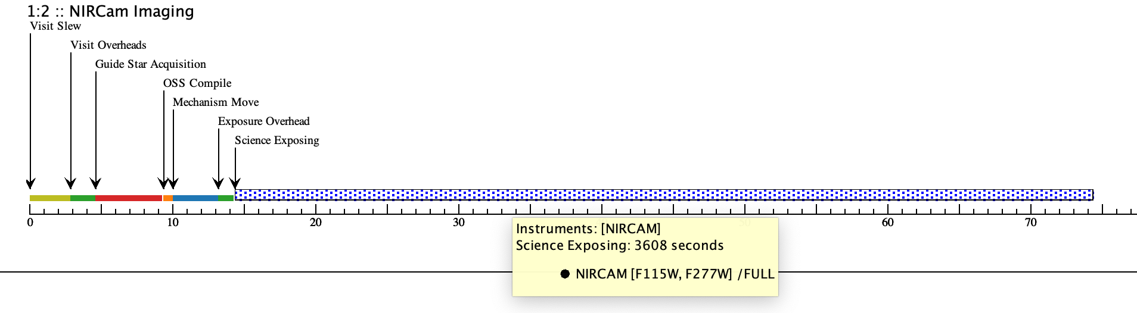
APT Graphical Timeline Examples
Initial visit, relatively short science exposure; overheads dominate
Hover cursor over any overhead or exposure to see more details.
A second visit, relatively fewer overheads, long science exposure

Slide 25
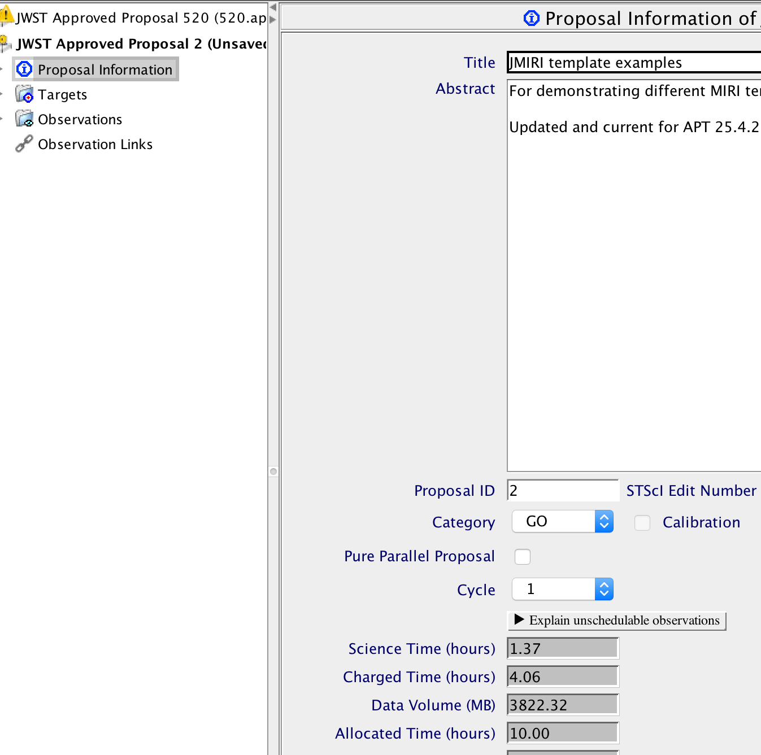
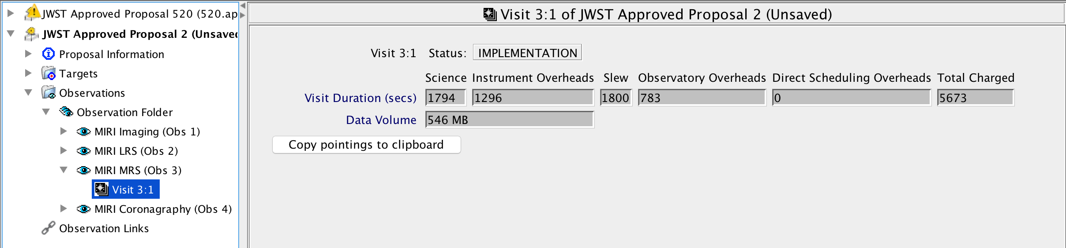
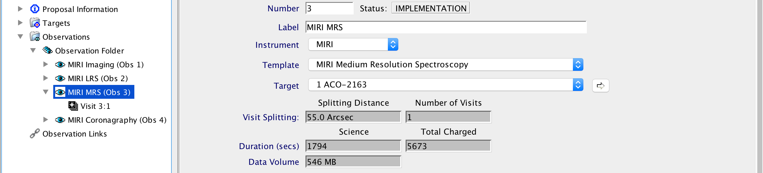
APT Science Time and Total Charged Time
Science time and total charged time (including overheads) can be viewed in APT at the proposal level, the observation level, and visit level.
Total for
proposal
Visit
level
Observation
level

Slide 26
APT Overhead Charge Corrections (Smart Accounting)
While designing and building an observing program, overheads can become overestimated as observations are added individually.
Ex: NIRCam and MIRI imaging requested on the same source, will likely be scheduled back-to-back.
Ex: Many targets closely spaced on the sky, will likely be scheduled in close succession.
In both cases, initial assumptions of a large 1800 s slew to start each observation are likely a significant overestimate.
Running Smart Accounting on your finished observations searches for and removes extra initial slews and other smaller inefficiencies that may have crept in.
Some programs will see a significant correction while others will not.
Note: While Smart Accounting may reduce your proposal’s total time request (which is good for you!), this adjustment is important in a larger sense, to provide the best estimate of overall observatory resource usage expected. So…
Always run Smart Accounting before submitting your proposal!
Notes:
An overestimation of overheads can occur during the designing of an observing program as each new observation is added. The overcharge can build up and will need to be accounted for at the end of the proposal process.
The Smart Accounting Tool looks at the overall proposal, and makes corrections where it can for these potential overcharges. If it is not up-to-date, you will see an APT Warning.

Slide 27
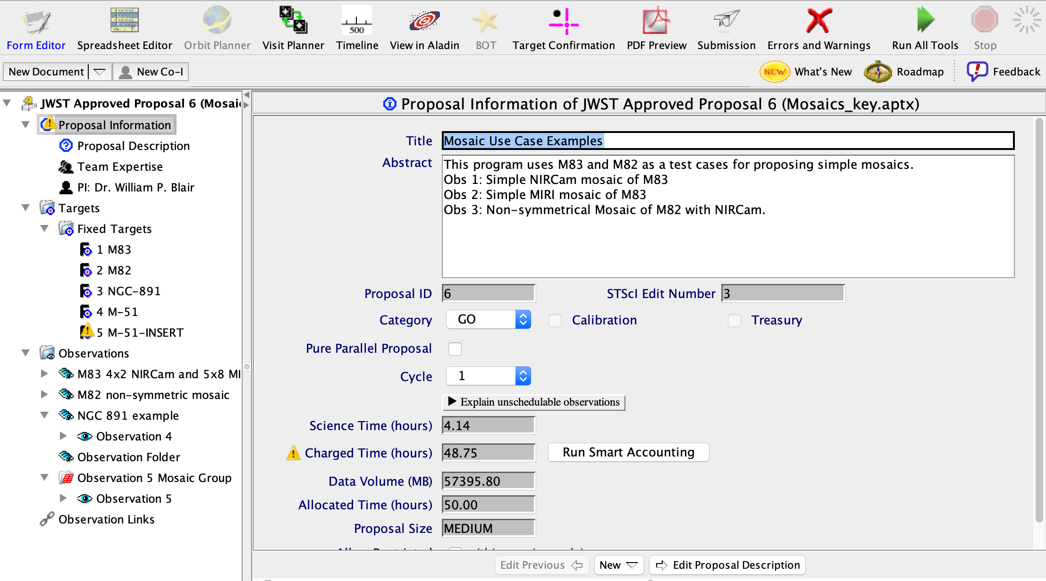
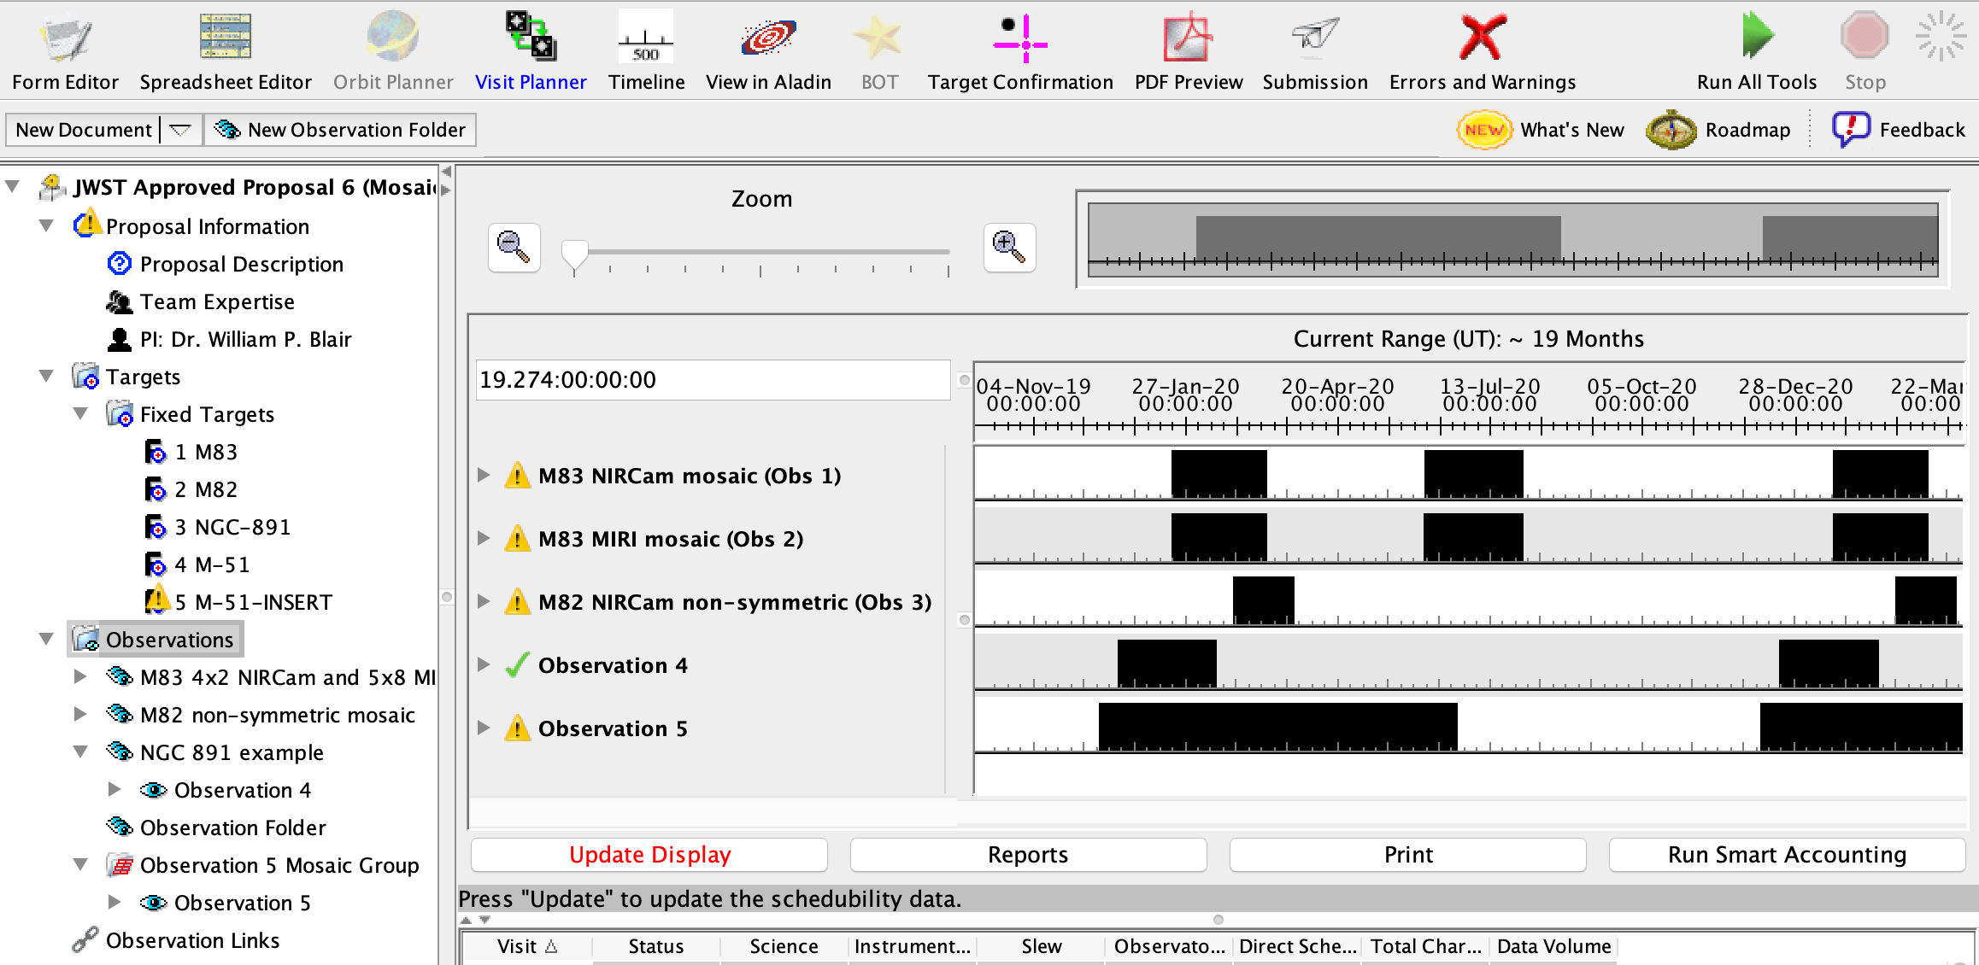
Where to find and run Smart Accounting in APT
Because of the importance of running Smart Accounting, APT provides several places where it can be invoked.
A button right on the Proposal Information page.
From within the Visit Planner
By clicking the “Run Smart Accounting” button at lower right.
Or simply by selecting your entire observation folder in the tree editor and running the “Update Display” button in the Visit Planner.

Slide 28
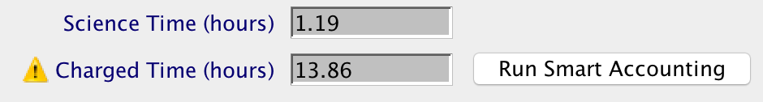
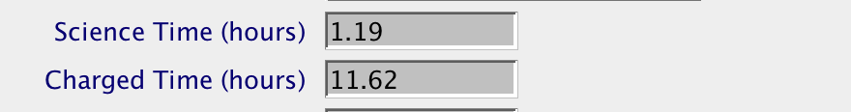
APT Smart Accounting Hint
To see the impact of Smart Accounting, note the total charged time on the Proposal Information page prior to executing the task. Then compare to the result when the task completes.
Before Smart Accounting Run
Note: This button only appears when APT thinks the accounting is out of date.
After Smart Accounting Run
Additional Resource: JDox Article: APT Smart Accounting

Slide 29
APT Science Time and Total Charged Time -- Summary
Science time vs. Total Charged Time is just informational for the proposer.
Proposals with short exposures will be dominated by overheads.
Proposals with relatively long exposures will have more balance.
That’s just the way it is for JWST observations. BUT…
The Time Allocation Committee (TAC) only sees the total resource request.
So don’t obsess over the “efficiency” of your proposal. Just concentrate on proposing the best science you can!

Slide 30
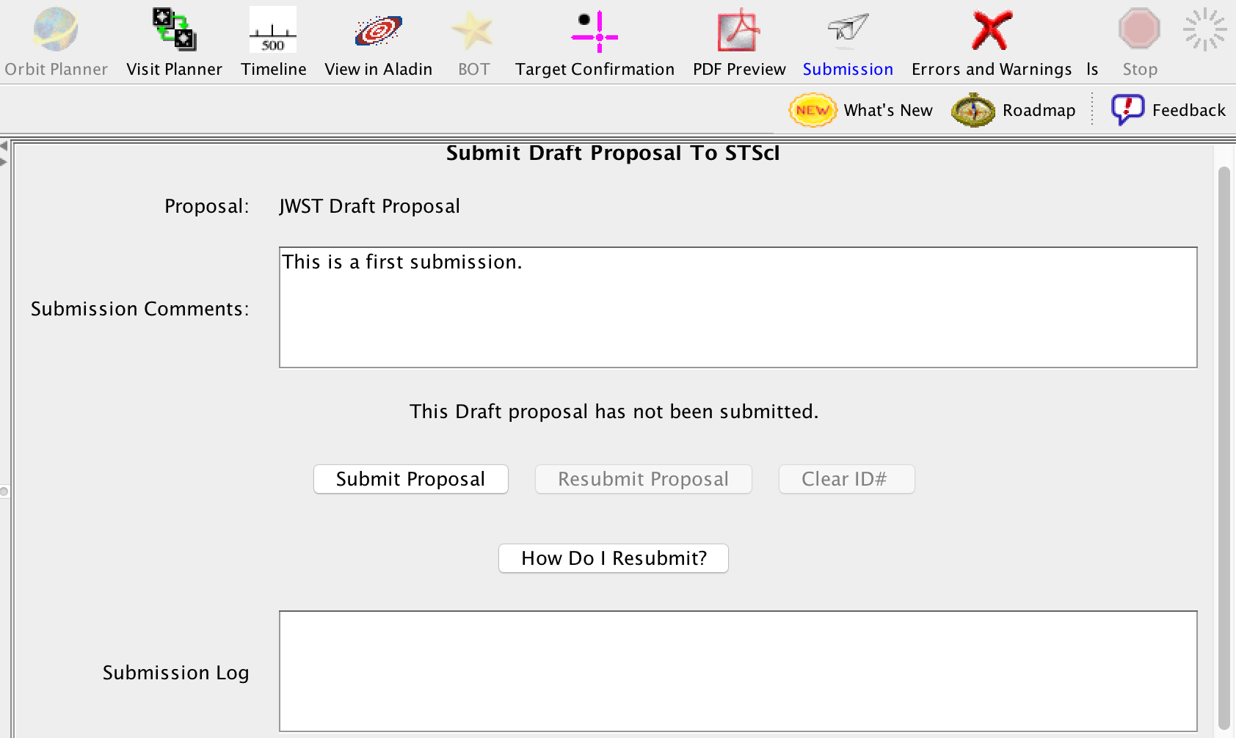
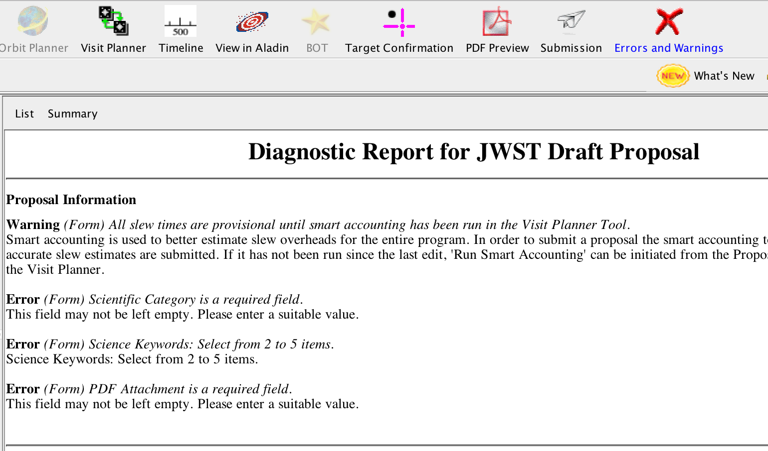
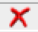
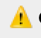
Proposal Submission
Prior to submitting a proposal, the following should be completed:
Run Smart Accounting
Run Visit Planner
Run Target Confirmation
Verify the Science Justification PDF is attached.
Review Errors and Warnings
You can hover over Errors or Warnings to see a description of the issue
Errors: appear when required information is missing or if unsupported values have been selected or entered into a field
Warnings: may or may not be a real problem, depending on the context, so you need to check.
Submit!
You cannot submit with Errors, but can submit with Warnings. Any diagnostics should be commented on.
Notes:
The Science justification PDF can be attached on Proposal Information page.

Slide 31
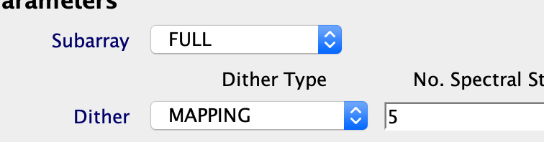
Additional Resources for Help with APT
JWST User Documentation Website https://jwst-docs.stsci.edu/, including
The JWST Astronomer's Proposal Tool Overview (and links therein)
Help with Individual APT Templates
Example Science Programs, each of which has a specific APT step-by-step guide.
YouTube Tutorial Videos https://www.youtube.com/jwstobserver, and in particular, the Playlist of APT-specific Videos
Context Sensitive Help within APT
Clicking on Blue headings within APT
opens a browser and points to
relevant JDox support information.
?
Notes:
Additional Resources:
Articles
https://jwst-docs.stsci.edu/
https://jwst-docs.stsci.edu/jwst-astronomers-proposal-tool-overview
https://jwst-docs.stsci.edu/apt-observation-templates
https://jwst-docs.stsci.edu/jwst-example-science-programs Video Tutorials
https://www.youtube.com/jwstobserver
https://www.youtube.com/playlist?list=PLTOSd8OgUP5qUTHoDsyOmdSNc66cyxi26

Slide 32
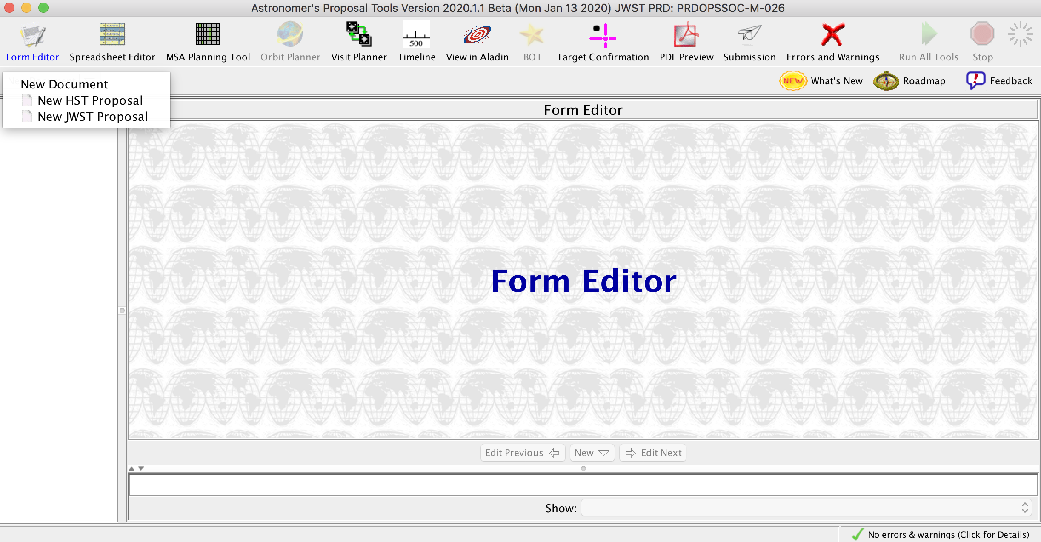
Thanks for Listening – Questions?

Slide 33
MSA Planning Tool (MPT)

Slide 34
A guide to JWST MOS terminology
MOS - Multi-Object Spectroscopy
the NIRSpec mode for obtaining spectra of 10-100s of specific targets simultaneously
MSA - Micro-Shutter Assembly
the array of very small shutters (0.2x0.46 arcsec) within NIRSpec that allows specific targets to be selected and contaminants to be blocked
MPT - MSA Planning Tool
the tool within APT for planning and optimising the MOS observations with the NIRSpec MSA

Slide 35
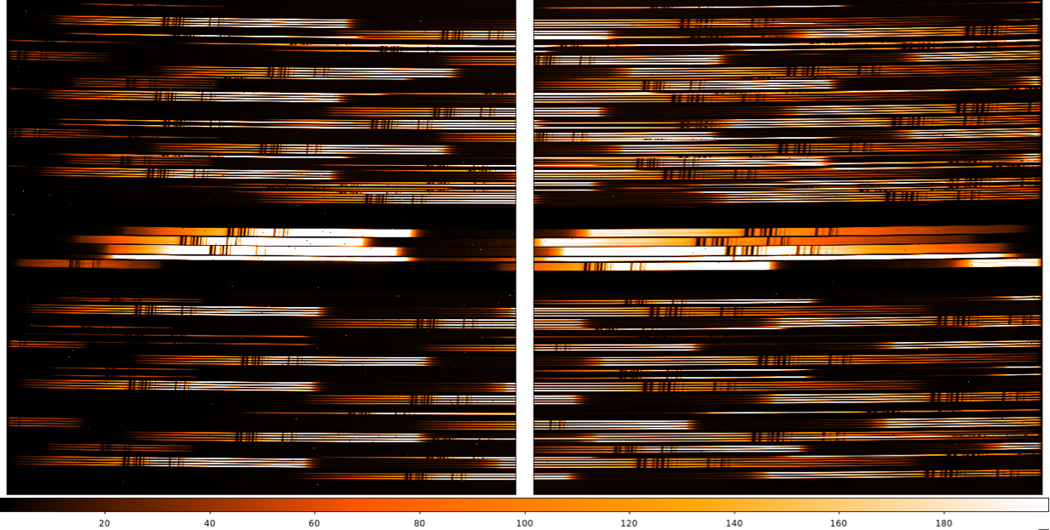
Why use MPT?
NIRSpec MOS can obtain spectra for 10s-100s of objects simultaneously
Targets are selected by opening a few of a grid of 250,000 micro-shutters
MPT optimises this “MOS mask” given your target catalogue
details on the MSA shutter array are in the “observing modes” session
strategies are covered in the MOS hands-on session
Example (flat-field test exposure) of 100 tightly-packed spectra (G395H grating)

Slide 36
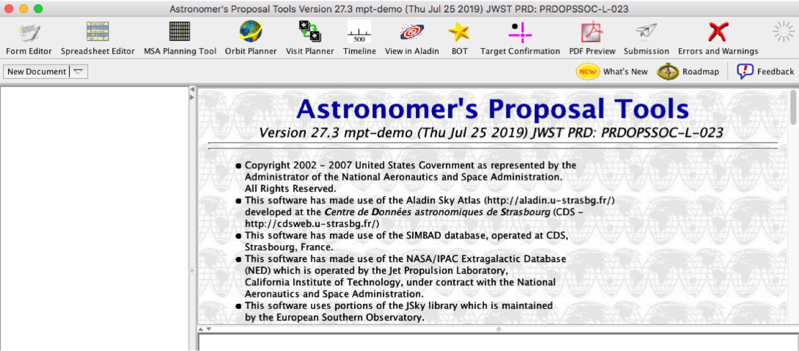
MSA Planning Tool (MPT) in APT

Slide 37
What is needed to run MPT?
An internet connection
access to the most up-to-date MSA shutter operability
checking for guide stars during planning
A complete and accurate astrometric catalogue
accurate source positions (<15mas relative accuracy)… may require NIRCam pre-imaging
MPT produces:
plans with 1 or more pointings
MSA configurations
target sets
One or multiple plans can be selected for a given observation

Slide 38
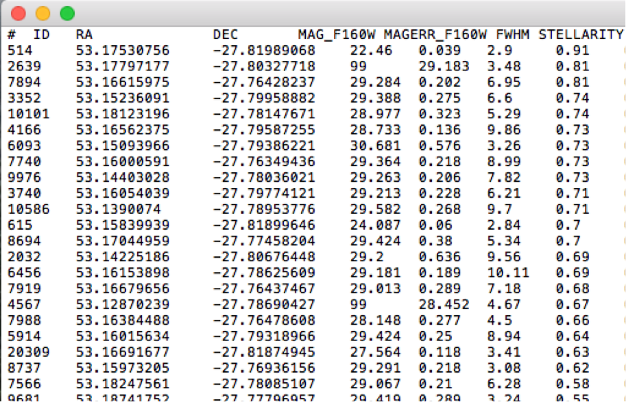

The catalogue
First step to create a MOS observation… upload complete catalogue of sources to the MPT
Catalogue should include all known sources in the field, to properly identify contaminants
Upload source catalogue as an ASCII file
It must contains J2000 RA and Dec expressed in degrees or hexadecimal
It cannot have duplicate IDs or NULL entries
Optional: Fluxes or magnitudes for the sources helps
Magnitudes are needed to properly define reference stars
Optional: Target priorities are recommended
The file can have a header, marked by “#”
Remember: the relative astrometric accuracy of the catalogue must be between 5 and 50 mas

Slide 39
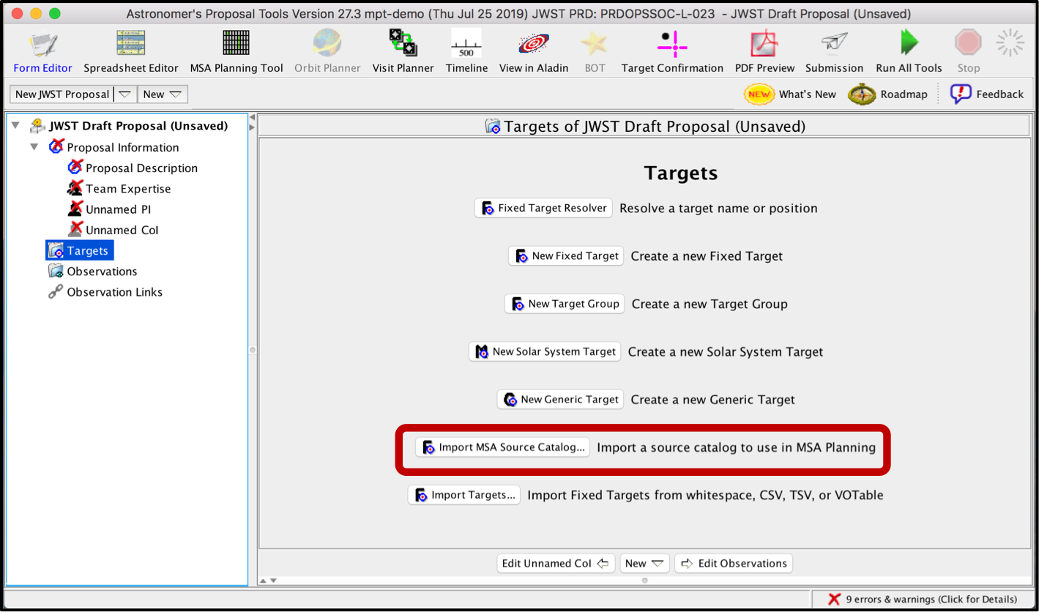
Load the catalogue as an MSA Source Catalogue Target
From the Form Editor

Slide 40
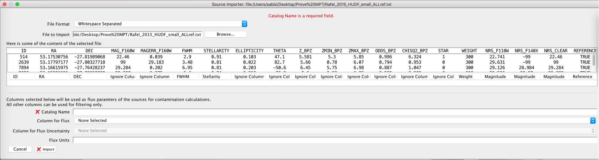

Catalogue importer
Column for Flux can be used for filtering sources when creating candidate sets
Weight can be used to prioritise targets

Slide 41
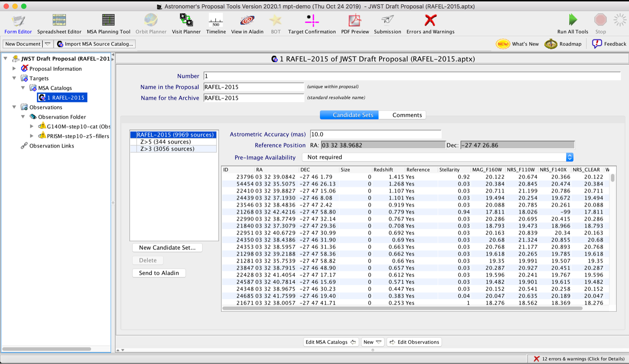
MSA Source Catalogue Target
MSA Catalog is now in the Targets Folder
Can create multiple candidate sets from a single catalogue
Visualisation of the catalogue via Aladin

Slide 42
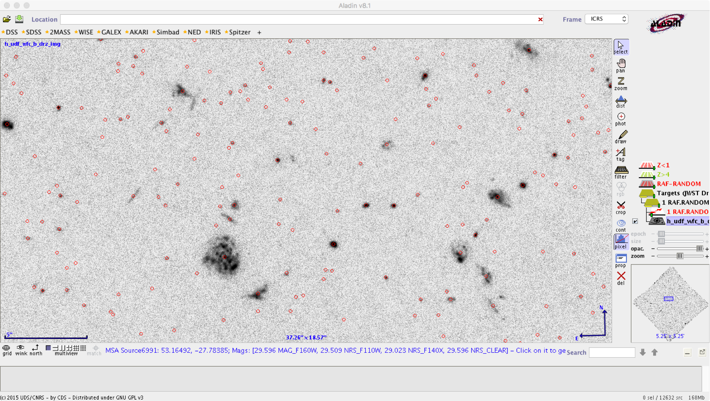
Catalogue sources displayed in Aladin

Slide 43
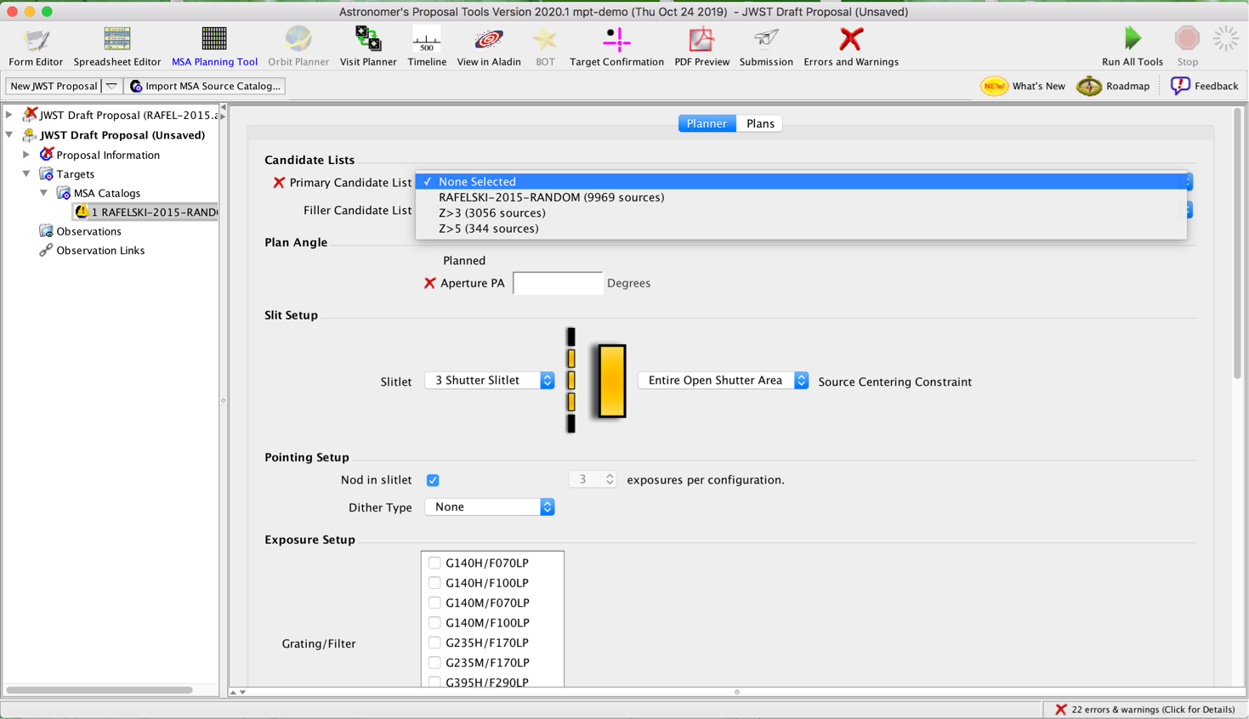
The MSA Planning Tool
MSA Planning Tool in the APT toolbar
The Planner tab is where you design MOS plans
Select candidate lists from your MSA Catalog
Aperture PA (position angle) is either a placeholder, or assigned to you by STScI (after acceptance)
Slitlet configuration and Centering Constraint should be chosen

Slide 44
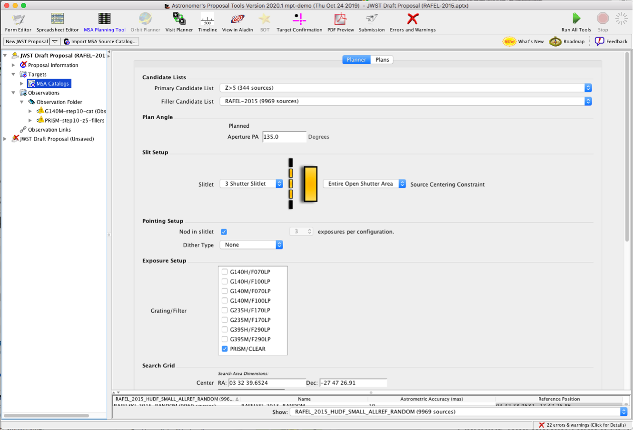
The MSA Planning Tool
The Planner is where you decide how to dither
Nodding moves the sources within the slitlet – no shutter reconfiguration
Fixed Dither moves the sources by a finite number of shutters specified by the user along the dispersion and/or the cross-dispersion direction.
Grating/Filter combination(s) must be selected to prevent spectral overlap in the chosen configurations

Slide 45
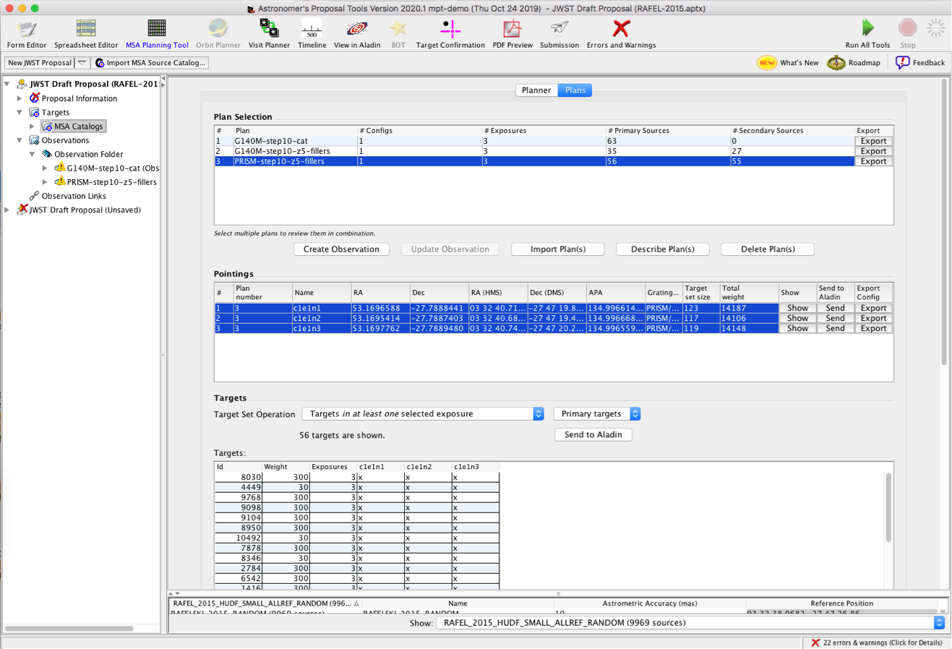
Examine and visualise a plan
The Plans tab is where you examine and visualise MOS plans
MSA shutter view
Collapsed shutter view
Send to Aladin (on-sky visualisation)

Slide 46
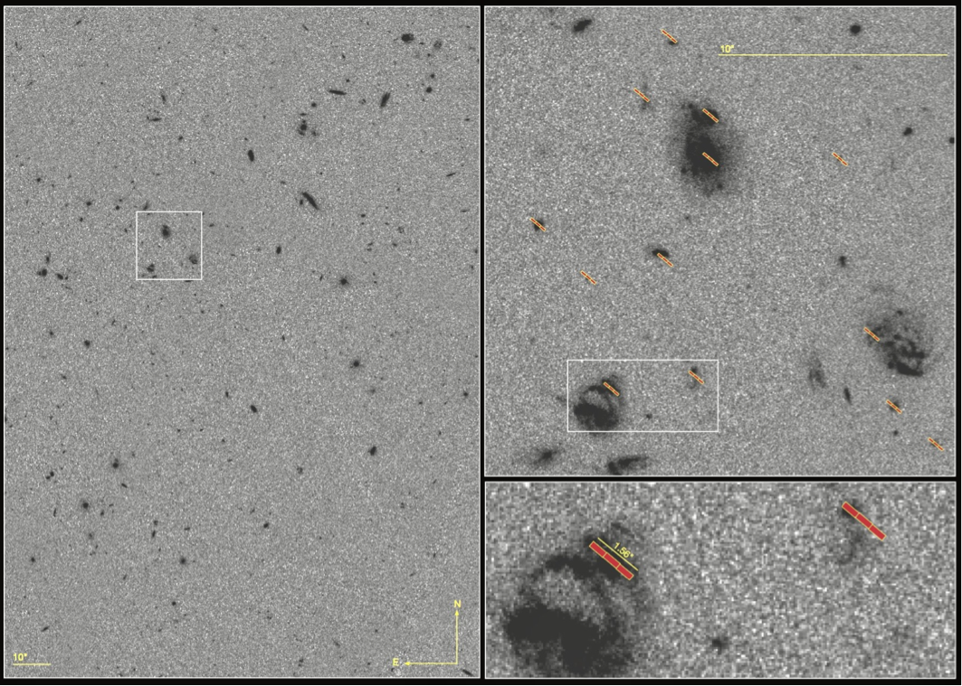
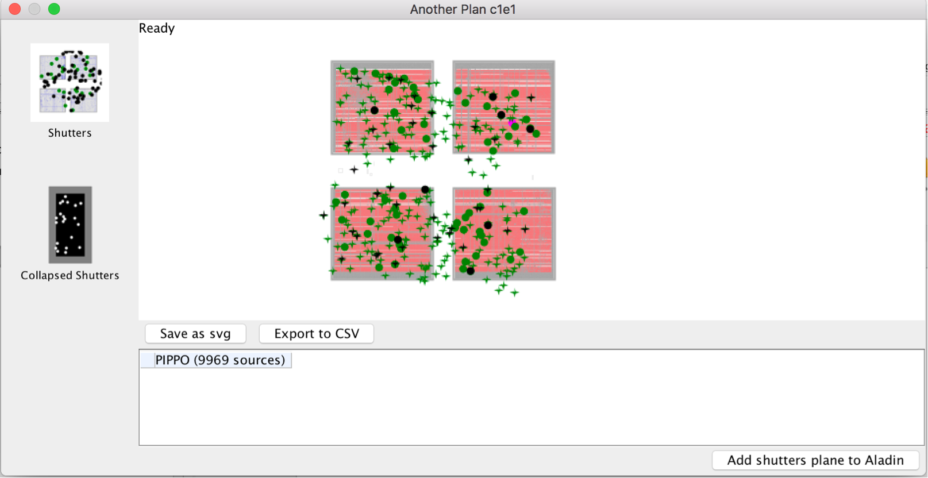
Examine and visualise a plan
Shutters projected onto the sky in Aladin
Targets on the MSA

Slide 47
Create an observation
From the Plans tab
Highlight a plan or plans
Select the pointings
Create Observation

Slide 48
Proposing for MOS
Remember: need a catalogue with accurate relative astrometry
<15mas relative accuracy
MOS will have a multi-step planning process
Final plans not possible until the program is accepted and scheduled (giving the actual Aperture PA)
A particular APA can be requested in a proposal, but must be strongly justified
Instrument overheads are not negligible - use APT/MPT for the estimate

Slide 49
Additional helpful hints
Dither!!! …to improve background subtraction, wavelength coverage, etc
Order your input catalogue by weight… during optimisation, MPT adds sources in the catalogue order
Use a Filler Set to maximise efficiency/multiplexing
Include Primary candidates in the Filler list to obtain additional observations of important sources
Weight only matters for Primary sources (not for Fillers)
If observability window is large, test optimisation for several APAs… if multiplexing differs significantly, consider including an Orient Special Requirement, with a minimum range of 30 deg
If using a high-res grating (GxxxH), attempt to place most sources on the leftmost quadrants (MPT orientation) to avoid detector cutoffs
Use Aladin to show the position of NIRCam parallels during NIRSpec exposures
Input catalogue should be as complete as possible to check for contaminants in commanded open (or known Failed Open) shutters
The MSA Configuration Editor can be used to amend MPT-optimised configurations. It can be found at the observation level in APT

Slide 50
Exposure Time Calculator (ETC)

Slide 51
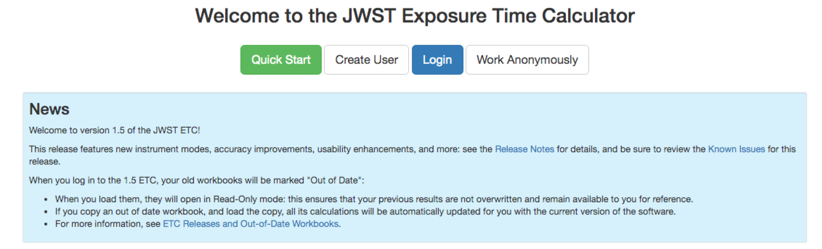
Where is ETC?
jwst.etc.stsci.edu
See also
Pontoppidan et al., Proc. SPIE. 9910, Observatory Operations: Strategies, Processes, and Systems VI, 991016. July 15, 2016 (https://arxiv.org/abs/1707.02202)

Slide 52
The “Pandeia” project
3D ETC engine
Python library
Reference database
Throughputs, detector noise, PSFs, …
Web application
(jwst.etc.stsci.edu)
User interface,
collaborative function
JWST
background
model
Integrated into web application or as a standalone tool

Slide 53
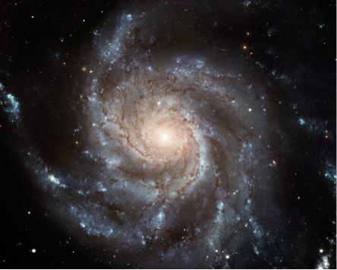
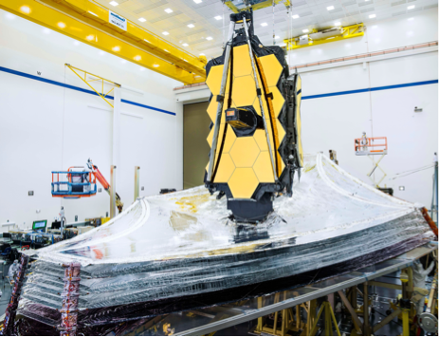
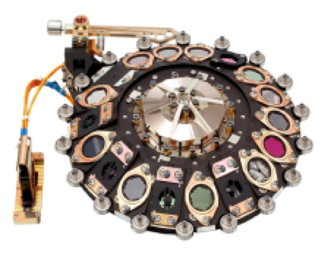
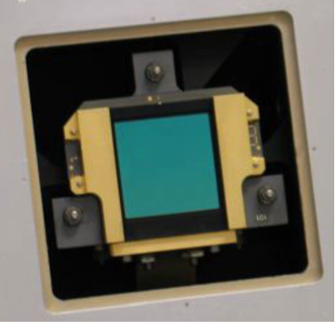
The engine algorithm
Space Telescope Instrument Detector

Slide 54
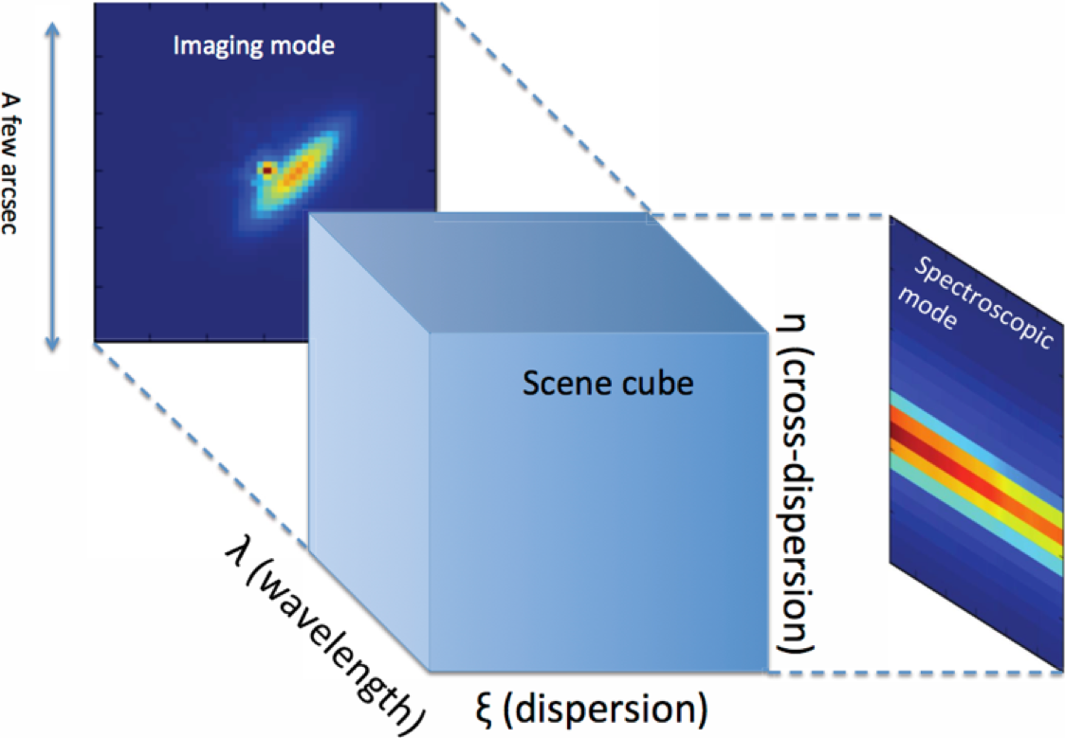
JWST ETC concept
Modern design
Signal (source + background) modelled in 3D
conserves flux
resolve lines
oversample JWST resolution
Pixel based:
Models the detector (e.g. correlated noise)
Final S/N calculation includes data analysis and
post-processing steps (“strategy”)
Allows the modelling of complex scenes (e.g. estimate contamination from bright sources)
Supports all JWST modes

Slide 55
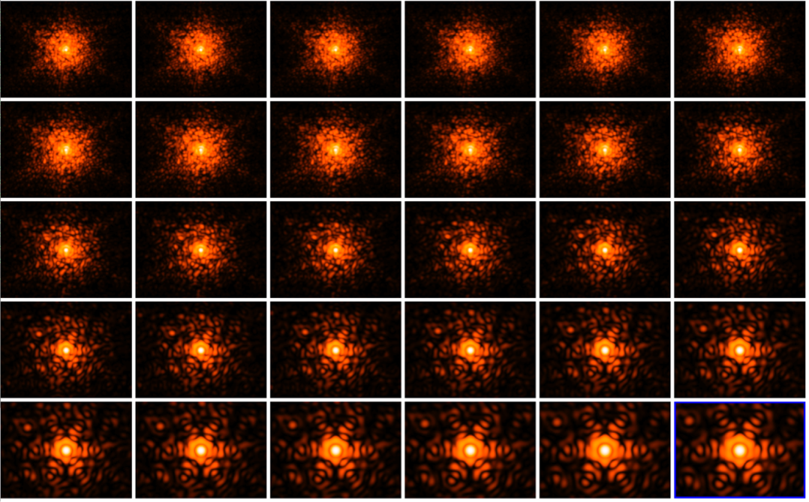
PSF library
Uses WebbPSF to calculate PSF including realistic wavefront errors
Almost 5000 individual monochromatic PSFs
Subsampled by integer factor of pixel size
NIRCam SW PSFs
(0.6-5.2 micron)

Slide 56
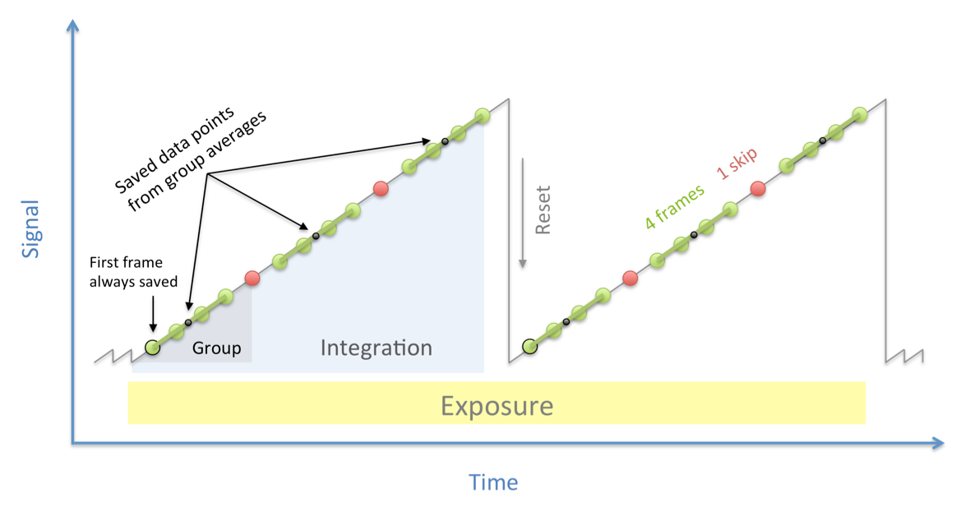
Readout terminology
subarray: the window on the detector being read out
frame: one complete read of the detector or subarray
group: a set of consecutive frames averaged onboard (some frames may be skipped)
integration: one non-destructive ramp
exposure: a set of consecutive integrations at the same pointing
dither: an exposure at a new pointing

Slide 57
Time terminology
exposure time: Time the detector is operating during a single exposure
includes resets
excludes initial synchronisation time
includes all integrations, but no repetitions per pointing, per tile, or per observation
measurement time: For any individual pixel, the interval between first and last measurements during a single integration, multiplied by the number of integrations per exposure
used to determine count rate
saturation time: For any individual pixel, the interval from reset to the final read of an integration, multiplied by the number of integrations per exposure
depends on exposure parameters, not target brightness or instrument throughput
exposure duty cycle: measurement time divided by exposure time

Slide 58
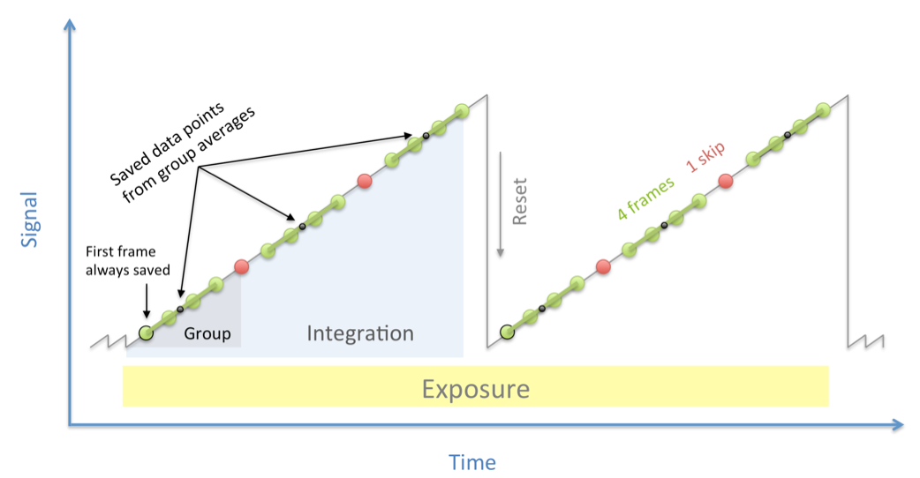

How is saturation treated in ETC?
Two types of saturation
Partial saturation: the integration saturates before it completes, but more than the minimum number of groups are unsaturated - DATA RECOVERED
Full saturation: the integration saturates before the minimum number of groups achieved - NO DATUM (for that pixel)
Usually, the minimum ngroups = 2

Slide 59
Tips for optimising detector set-up
More frames per integration decreases read noise
Longer groups decreases data volume
Shorter groups decreases chance of cosmic ray hit per group
More groups per integration make the cosmic ray correction better
Longer integrations may make ramp fitting more certain
More dithered exposures decreases flat-field errors and the impact of bad pixels
Note: in ETC, all exposures are assumed to be dithers, except for time-series observations
Readout patterns that skip lots of frames have higher read noise, but slightly better duty cycle

Slide 60
JWST ETC features
Workbooks
Organise several ETC calculations into a workbook
A workbook can contain multiple sources, scenes and calculations
Workbooks remain in your MyST account, and are shareable
Reusability
Calculations in a workbook start with reasonable defaults
Simply copy a calculation, modify the inputs as desired and recalculate
Batch expansion
Efficiently run a batch of many calculations
Calculation is duplicated N times varying only the selected parameter
Expansion over e.g. Ngroups offers a way to show the behaviour of SNR as a function of “exposure” time
Auto-update
Changes made to the input, flow through to associated forms and calculations

Slide 61

Scenes and sources
Scene: small postage-stamp of the sky (a few arcsec on a side)
A scene can have no source (just background) or multiple sources
Scenes can be reused in multiple calculations
Source: specify SED, normalisation, extinction, emission lines and shape
Each sources can be reused in multiple scenes
Location: x,y offset (with orientation) within the postage stamp scene
Shape: point source or extended (flat, Gaussian, Sersic, power law…)
Spectrum:
Continuum: flat, black body, power law, templates
Lines: centre, width, flux
Normalise to magnitude/flux in JWST or HST bandpass, or at a λ
Upload a spectrum (ASCII or FITS format)

Slide 62
Issues to think about when using ETC
ETC is a highly versatile tool
There are many parameters affecting ETC sensitivities and program preparation
Different read-out patterns change the read noise
Be aware of saturation
Which background subtraction scheme?
Is the background correct for your target?
What extraction aperture is optimal? (Point or extended source?)
Does your extraction aperture contain contaminating flux from other sources in the scene?
Remember: ETC approximates our current best knowledge and understanding of performance. There are remaining uncertainties associated with system throughputs, detector noise properties, etc., which will remain unknown until JWST is in flight.
BEWARE: The ETC is not intended to be a complete observation simulator

Slide 63
Useful links
JWST ETC (v1.5)
https://jwst.etc.stsci.edu/
Documentation:
ETC introduction
Links to all pages, video tutorials and more
https://jwst-docs.stsci.edu/jwst-exposure-time-calculator-overview
ETC release notes, known issues and FAQ (@ JWST Help Desk)
JWST Help Desk ETC FAQ
JWST Help Desk ETC known issues
JWST Community Lecture Webcasts
“The JWST Exposure Time Calculator” - Klaus Pontoppidan (Nov 2019)
“JWST ETC Demo” (interface demonstration) - Swara Ravindranath (Feb 2017)

